Slide 1
Monetary and Financial Market intervention around the World
China’s Gradualistic Economic Approach and Financial Markets

Slide 2
background
1. “crossing the river by touching the stones”
it typically takes months, and even quarters, for the economy to react to a change in policy.
the government continues to play a central role in many aspects of the economy.
2. After 30 years of rapid growth, however, its economy has become increasingly complex.
Can China continue to use its gradualistic approach in the presence of active financial markets?

Slide 3
example
1. China’s post 2008 stimulus program
financial markets may cause a temporary policy initiative to have a larger and more permanent impact on the economy than the government intended.
The liberated financial system did not allow the government to experiment with a temporary stimulus that could be reversed easily soon after its inception.
2. The breakdown of the new installed circuit breakers in China’s stock market in January 2016
This fast reaction demonstrates that policymakers may not have adequate time to gradually adjust underdeveloped policy schemes in reforming the financial system.

Slide 4
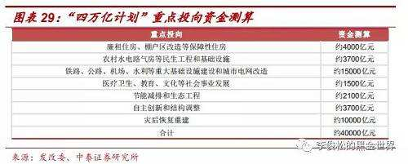
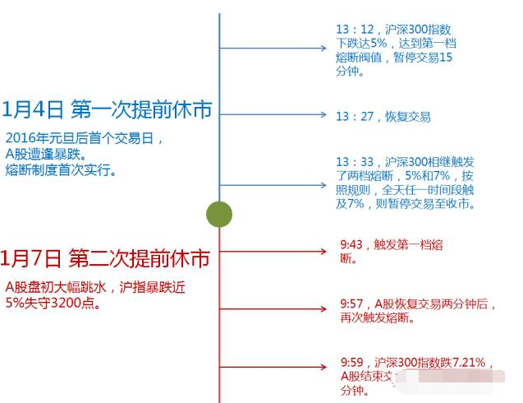

Slide 5
several key ingredients
First, a policymaker uses private agents’ investment decisions as a signal to infer their information about economic fundamentals. This feature motivates the policymaker to adopt gradual policy changes, even though they are inefficient ex post after the private agents make their investment decisions.
Second,
Without financial market
With financial market,policymaker can make commitment
With financial market,policymaker can not make commitment-China

Slide 6
The Model Setup
1. t = 0, 1, 2
2. policymaker and a continuum of identical private firms
3. The economy is subject to two fundamental shocks, θ and ε
4. The policymaker makes to maximize a quadratic objective function (a1,t=1;a2,t=2)
5. Private agents choose k to maximize the profit Π = y (k) − c (k) (t=1)

Slide 7
A. Defining Gradualism
Under the gradualistic policy approach, the policymaker’s action at
t = 1 is below the best prediction of θ . That is, a1 < θ(均值)
B. The Perfect-Information Benchmark
In development economics, it is straightforward from the government’s objective that the policymaker chooses a1 = a2 = θ , and private agents choose log k = θ + 2θε

Slide 8
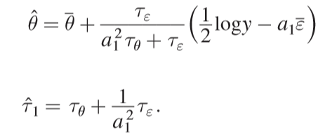
Government Gradualism Absent Financial Markets
In the absence of fully developed financial markets
private agents must receive financing from state-controlled banks
the policymaker has chosen his policy a1 at t = 1
private agents output y (k) at the end of t
2. At the beginning of t = 2
the policymaker chooses a2 at t = 2 to maximize the continuation problem:

Slide 9
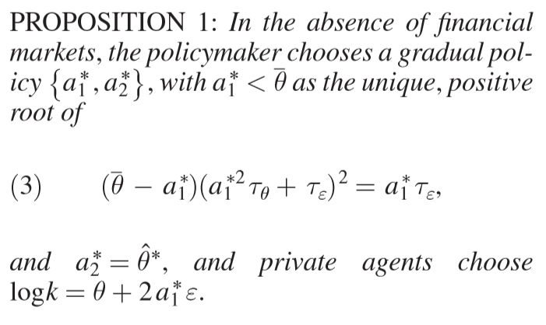
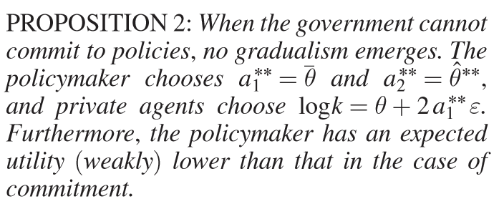

Slide 10
Time Inconsistency with Financial Market
A. “Principled Approach” with Commitment
the government has a commitment technology that allows it to credibly set policies ex ante that may not necessarily be optimal ex post
The policymaker precommits to choosing a1
B. “Pragmatic Approach” without Commitment
private agents must form rational expectations about what policy a 1 the policymaker will choose. In this case only policies that are optimal ex post can arise in equilibrium

Slide 11
thanks

