Slide 1
Competition,financial innovation and commercial bank loan portfolios
Rebecca Zarutskie
presenter: Xujiao Ding

Slide 2
content
01
02
Introduction
Related literature
03
04
Empirical framework and data
Estimation results
3.1 Empirical framework
3.2 Data and descriptive statistics
3.3 Trends in key variables, 1976-2003
4.1 Bank loan portfolios and securitization
4.2 State-wide and national deregulation
4.3 Economic magnitudes
05
Conclusion

Slide 3
01
Introduction

Slide 4
01

Background
A wave of state-wide deregulations beginning in 1976 ,national deregulation beginning in 1994 ,which made banks more competitive and the number of banks decreased.
The securitization markets expanded rapidly at the same time.

Question
How did the larger consolidated banks and the remaining smaller banks co-exist and compete for depositors and borrowers?

Slide 5
01

Motivated by this question
Examining how banks’ loan portfolios change in response to deregulation and growth in securitization markets over the period 1976– 2003 and whether the response varies by bank size and age.
Examine how bank loan portfolios change during two periods of deregulation in US commercial banking markets – the period of state-wide deregulation between 1976 and 1994 and the period of national deregulation in which states adopted the provisions of the Riegle-Neal Interstate Banking and Branching Efﬁciency Act of 1994.
Examining how the pricing of loans changes for smaller versus larger and younger versus older banks in response to deregulation enforces this view.

Slide 6
01

Findings
1. Larger banks and younger banks focus more on hard information loans.
2. All banks engage in more real-estate-backed lending over the period 1976–2003 and the increased lending is proportional to the level of securitization in the loan market.
3. Larger banks and younger banks disproportionately shift their lending toward real-estate-backed loans, particularly commercial real-estate-backed loans, whereas smaller banks and older banks maintain greater shares of their loan portfolios in unsecured commercial and personal loans.
4. Larger banks and younger banks charge lower interest rates in response to an increase in securitization and deregulation.

Slide 7
02
Related literature

Slide 8
02

Studies on the impact of competition on commercial banks, which made lending primarily focus on soft information loans.
A different set of studies suggests that size and age may inﬂuence how banks react to competitive forces.
Some studies show that securitization tends to lower the costs of lending for borrowers whose loans are sold or who borrow from banks that securitize loans.

Slide 9
03
Empirical framework and data

Slide 10
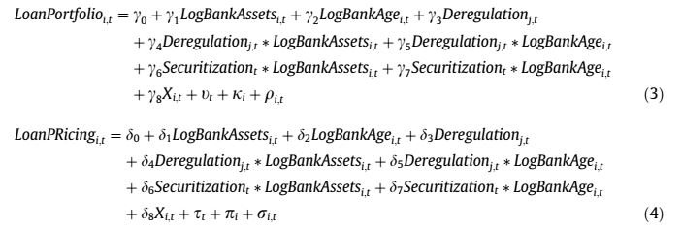
03
3.1 Empirical framework



Slide 11
03
Notations
the fraction of a bank’s loan portfolio represented by a particular loan category
the value of securitized loans in a loan category divided by the value of loans in this category held by commercial banks
Include controls for other bank-level and market-level characteristics that may infuence banks’ loan portfolios
To test the extent differences in post-deregulation lending behavor by different banks is driven by the rise in securitization markets

Slide 12
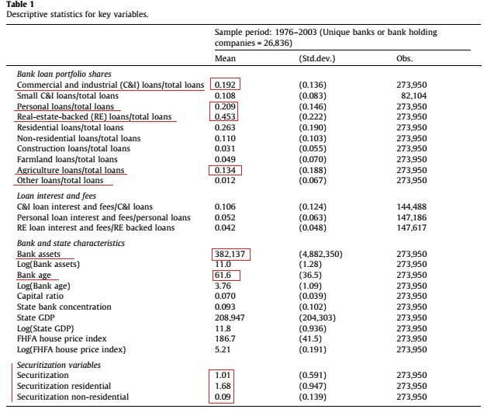
3.2 Data and descriptive statistics
Data sources
Call Reports of Condition and Income
Flow of Funds Accounts
The Call Reports began to track interest and fee income by loan category in 1984
Securitization is the value of loans out-standing in a given year that have securitized as reported by the Flow of Funds accounts divided by the value of loans commercial banks’ balance sheets

Slide 13
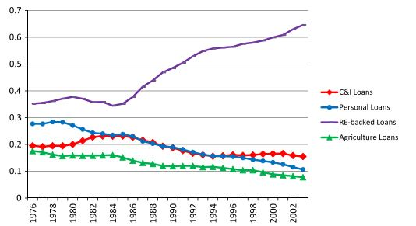
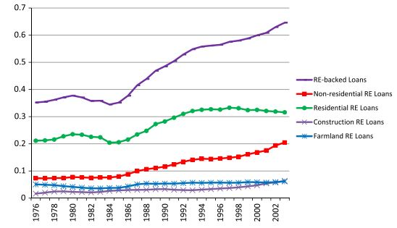
3.3 Trends in key variables,1976-2003

Slide 14
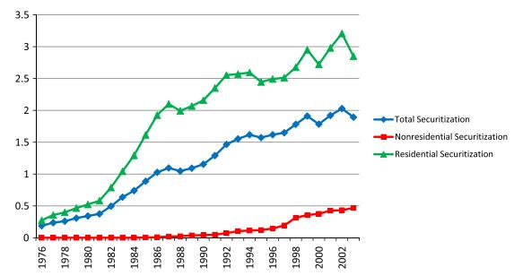
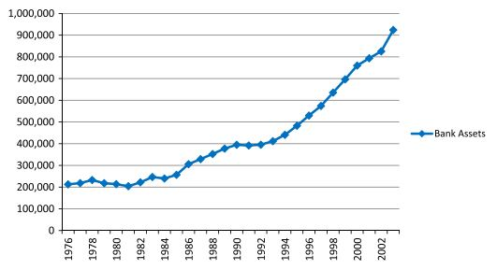
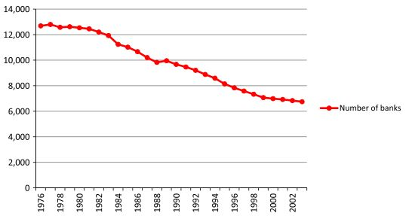
3.3 Trends in key variables,1976-2003

Slide 15
04
Estimation results

Slide 16
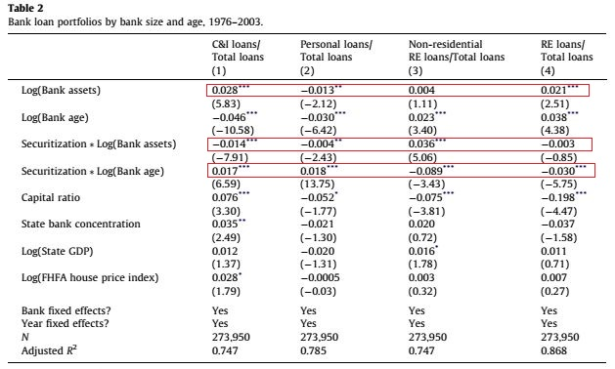
4.1 Bank loan portfolios and securitization,1976-2003
1. larger banks makes fewer C&I and personal loans when have greater securitization
2. larger banks make more non-residential real-estate-backed loans
3. Older banks make more C&I and personal loans as securitization increases
4. Older banks reduce real-estate-backed lendings,particularly non-residential real-estate-backed lendings as securitization increases

Slide 17
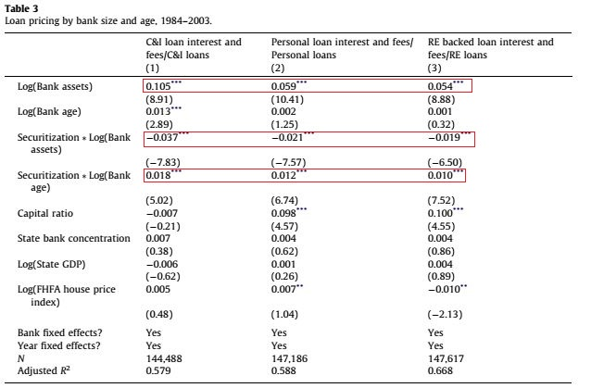
4.1 Bank loan portfolios and securitization,1976-2003
1. Larger banks increasingly lower their fees relative to smaller banks as securitization increases
2. Older banks charge higher fees as securitization increases
3.The rise in real-estate-backed loan securitization over the sample period led to an expansion of borrowers and reduces lending cost,especially among the largest and youngest banks

Slide 18
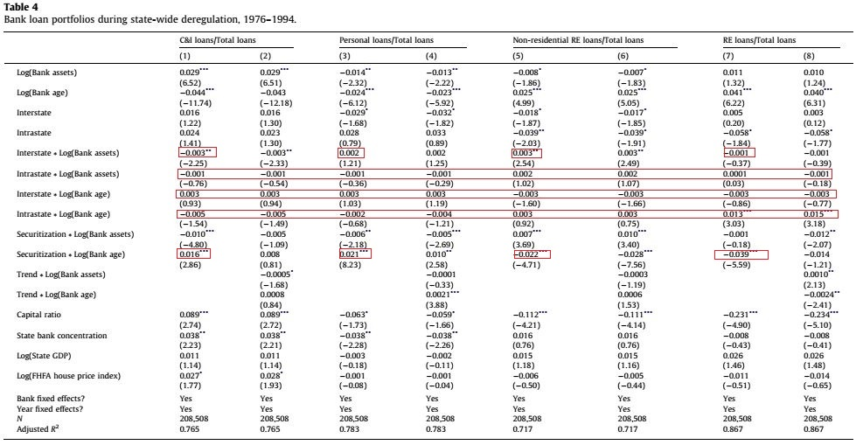
4.2 State-wide and national deregulation
1. Deregulation by bank size does not have a significant impact on lending to personal loans or all real-estate-backed loans
2. There is no significant impact of deregulation on lending by bank age across all categories

Slide 19
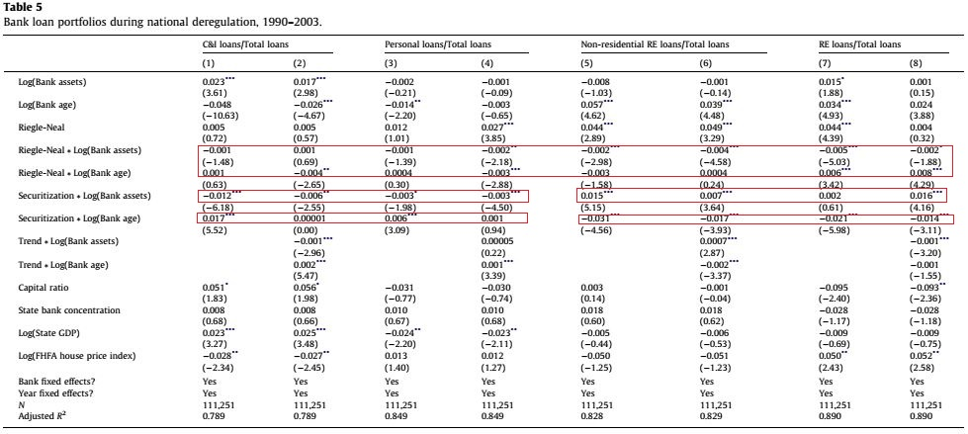
4.2 State-wide and national deregulation

Slide 20
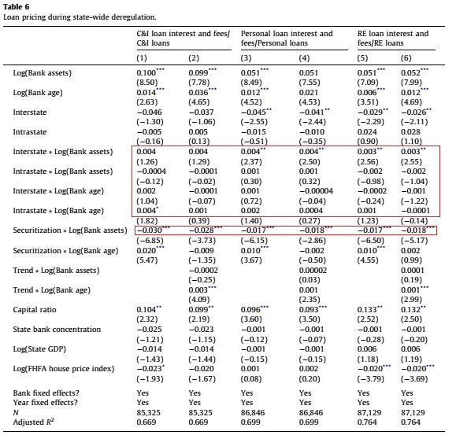
4.2 State-wide and national deregulation
1. Larger banks will charge lower interest and fees as securitization increase
2. Securitization is the main driver of lower interest and fees.

Slide 21
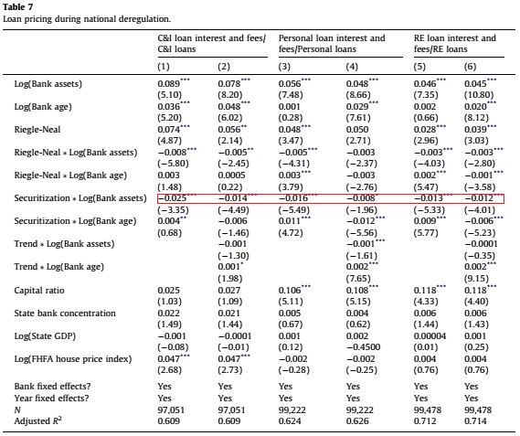
4.2 State-wide and national deregulation
Larger banks will charge lower interest and fees as securitization increase

Slide 22
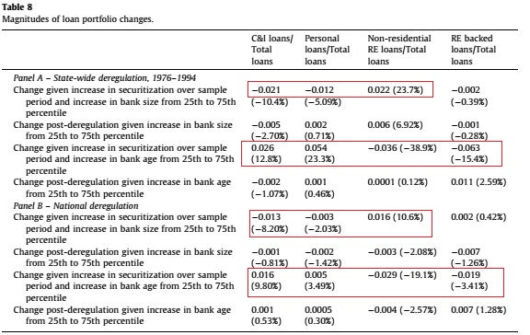
4.3 Economic magnitudes
1. Deregulatory events have much smaller impact on in terms of economic magnitudes on bank loan portfolios

Slide 23
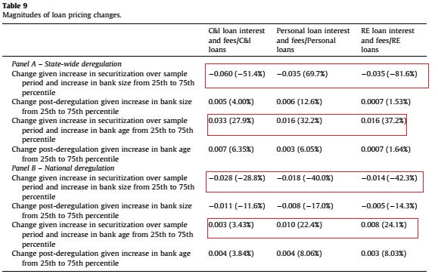
4.3 Economic magnitudes
1. Larger and younger banks shift their lending towards real-eatate-backed
2. Smaller and older banks keep more of the loan portfolio in unsecured commercial and personal loans
3. Securitization enters more strongly as an explanatory factor in the shifts in commercial banks’ loan portifolio

Slide 24
05
Conclusions

Slide 25
05
All banks engage in more real-estate-backed loans and this increase in lending is proportional to the level of securitization in the loan market
Larger and younger banks make more to non-residential real-estate-backed loans compared to smaller and older banks

Slide 26
07
3 Smaller and older banks make more unsecured commercial and personal loans
4 Larger and younger banks charger lower interest and fees in response to the rise in securitization

Slide 27
thanks

