Slide 1
“Time for a Change”: Loan Conditions and Bank Behavior when Firms Switch Banks
VASSO IOANNIDOU and STEVEN ONGENA
汇报人：赵静艺

Slide 2
Introduction
Academics and industry observers point to switching costs as a key source of bank rents. Hold-up problems. An analysis of loan conditions is a first step in assessing the role that switching costs play in credit markets.
DATA: the public credit registry of Bolivia between March 1999 and December 2003.
“What loan rate did the inside bank offer to the switcher?” and “Is this rate higher than the one offered by the outside bank?”
Loan rate cycle
Which banks obtain smaller discounts and experience a shallower loan rate cycle?

Slide 3
Outline
I. Hypotheses and Related Literature
II. Data and Descriptive Statistics
III. Results
IV. Conclusion

Slide 4
I. Hypotheses and Related Literature
A. Hold-Up Models: Hypotheses and Assumptions
B. Empirical Findings in the Literature

Slide 5
A. Hold-Up Models: Hypotheses and Assumptions
Von Thadden(2004):
four testable hypotheses
(H1) Each period firms may switch banks (i.e., they obtain new loans from new outside banks instead of one of their existing inside lenders).
(H2) Firms that switch receive a loan rate offer from an outside bank that is lower than the offer received from their inside bank.
(H3) Over time, the outside bank becomes an insider and extracts rents from good firms.
(H4) Because of adverse selection, a higher proportion of switching firms is worse in terms of unobservable risk characteristics than if the firms had been randomly drawn from the population.
Banking models are founded on two key assumptions: (A1) Relationships mitigate informational asymmetries between firms and banks. (A2) Relationships create informational asymmetries between inside and outside banks that are alleviated by observable firm information.

Slide 6
B. Empirical Findings in the Literature
A number of recent papers explore the impact of relationship, firm, bank, and market characteristics on the probability of a firm staying with or switching from/to a bank and the impact of relationship duration on loan rates and other contract terms (Boot (2000), Berger and Udell (2002), and Degryse and Ongena (2008) review this literature).
Ongena and Smith (2001), Farinha and Santos (2002), and Gopalan, Udell,and Yerramilli (2007) study why firms switch to new banks.
Ongena and Smith (2001) and Farinha and Santos (2002) find that the likelihood that a firm replaces a relationship increases in duration. The number of bank relationships that the firm maintains also negatively influences the length of a relationship. These studies also find that, ceteris paribus, young, small, high growth, intangible, constrained, or highly leveraged firms switch banks faster.
An extensive set of papers studies the impact of relationship duration on loan rates. In Berger and Udell (1995) find that loan rates decrease in relationship time, which is evidence against hold-up. Petersen and Rajan (1994),find that loan rates do not change in relationship time.Degryse and Van Cayseele (2000), Pozzolo (2004), and Degryse and Ongena (2005), on the other hand, find that loan rates increase in relationship time, consistent with the hold-up hypothesis.
Schenone (2009) studies the relationship between loan rates and the intensity of a lending relationship before and after a firm’s Initial Public Offering (IPO) .

Slide 7
II. Data and Descriptive Statistics
Data from the Bolivian public credit registry, Central de Informaci´on de Riesgos Crediticios (CIRC) between March 1999 and December 2003 :
For each loan, we have information on the date of origination, maturity date, contract terms, and ex post performance.
For each borrowing firm, we have information on their industry, physical location, legal structure, total bank debt, banking relationships, credit rating, and past repayment history.
Information sharing：information on all outstanding loans of the customer for the previous 2 months.
Information asymmetries remains.

Slide 8
II. Data and Descriptive Statistics
Installment and single-payment loans：94% (66%) of the total dollar value (number) of loan initiations . 33,084 loan initiations of installment and single-payment loans to 2,805 firms (of which 59% are corporations and 37% are partnerships or sole proprietorships)
More than 96% of these contracts are denominated in US$.
The Herfindahl-Hirschman Index (HHI) equals 1,335 in the beginning of our sample period and never exceeds 1,587.The HHI for new loans starts at 1,427 and never surpasses 2,334.In the small regions outside the three large regions (La Paz, Cochabamba, and Santa Cruz, which account for more than 90% of loan initiations), the HHI varies between 3,000 and 7,000.
The corporations in our sample are much larger than the partnerships or sole proprietorships. At sample entry, the average (median) corporation has $600,000 ($80,000) in bank debt outstanding, while the average (median) partnership or sole proprietorship has only $290,000 ($50,000). Nearly 25% of the firms in our sample are in the retail trade industry, 18% are manufacturing firms, and 11% are real estate firms.
Only 20% of our sample firms have multiple relationships, and there is a positive correlation between firm size and the number of relationships.
The incidence of collateral in our sample is only 24% .Low.

Slide 9
III. Results
A. Switching
B. Loan Rates for Switchers
A.1. Definitions
A.2. Statistics
B.1. Matching
B.2. Switching Loans Matched with Loans from Inside or Outside Banks
C. Loan Rates after Switching from the Outside Banks
C.1. Main Results and Robustness Analysis
C.2. Hold-Up and Alternative Explanations
C.3. Other Loan Conditions
D. Adverse Selection: Loan Repayment and Information Sharing

Slide 10
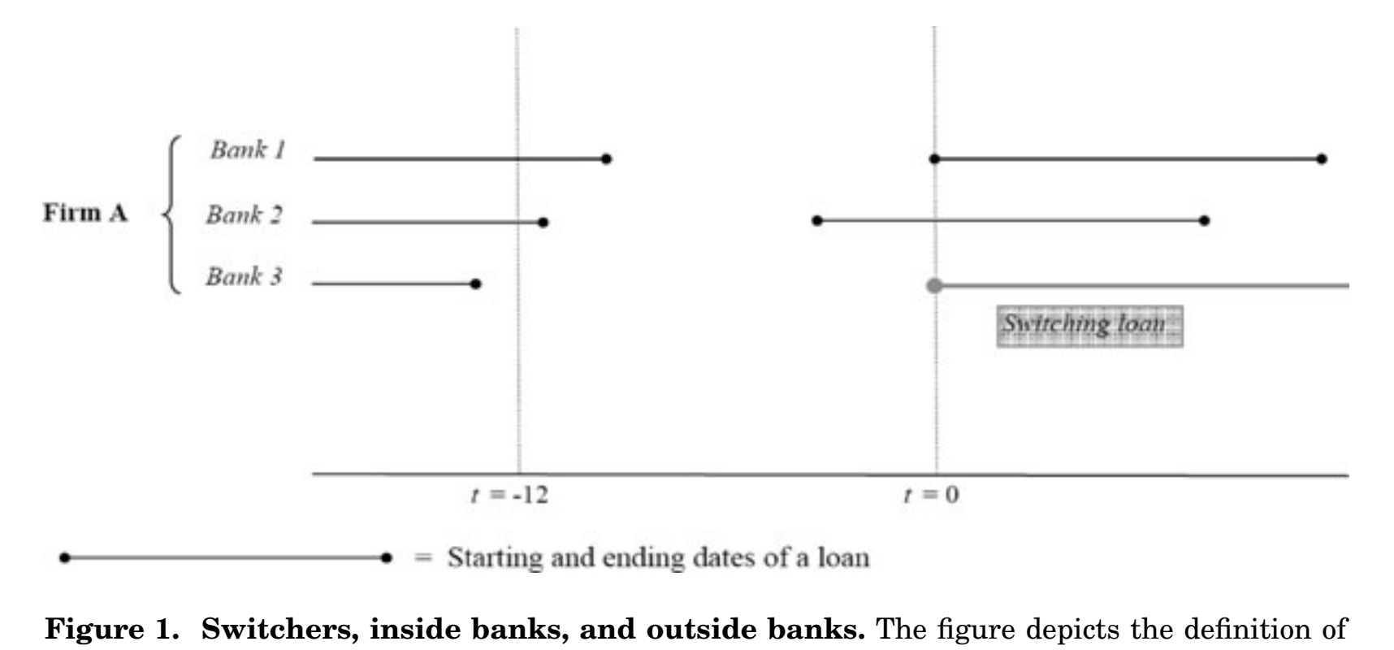
switching loan / nonswitching loan
outside banks / inside banks
A lending relationship encompasses any form of used or unused credit (including credit cards, credit lines, overdrafts, and discount documents)
A. Switching
A.1. Definitions
A.2. Statistics

Slide 11
The data set yields 1,062 switching loans granted to 615 firms, among the 33,084 loan initiations of installment and single-payment loans (H1) .
3% of the loan originations
22% of the 2,805 firms in our sample switch banks during our 5-year sample period (i.e., 4.5% per year)
Among the 615 firms,64% switched only once, 20% switched twice, and 16% switched more than two times.
77% are corporations and 20% are partnerships or sole proprietorships.
after conditioning on legal structure, switchers are larger than the other firms in our sample. firms that switched more than once during the sample period are even larger.
the distribution of switchers across industries is very similar to the overall sample.
A. Switching
A.1. Definitions
A.2. Statistics

Slide 12
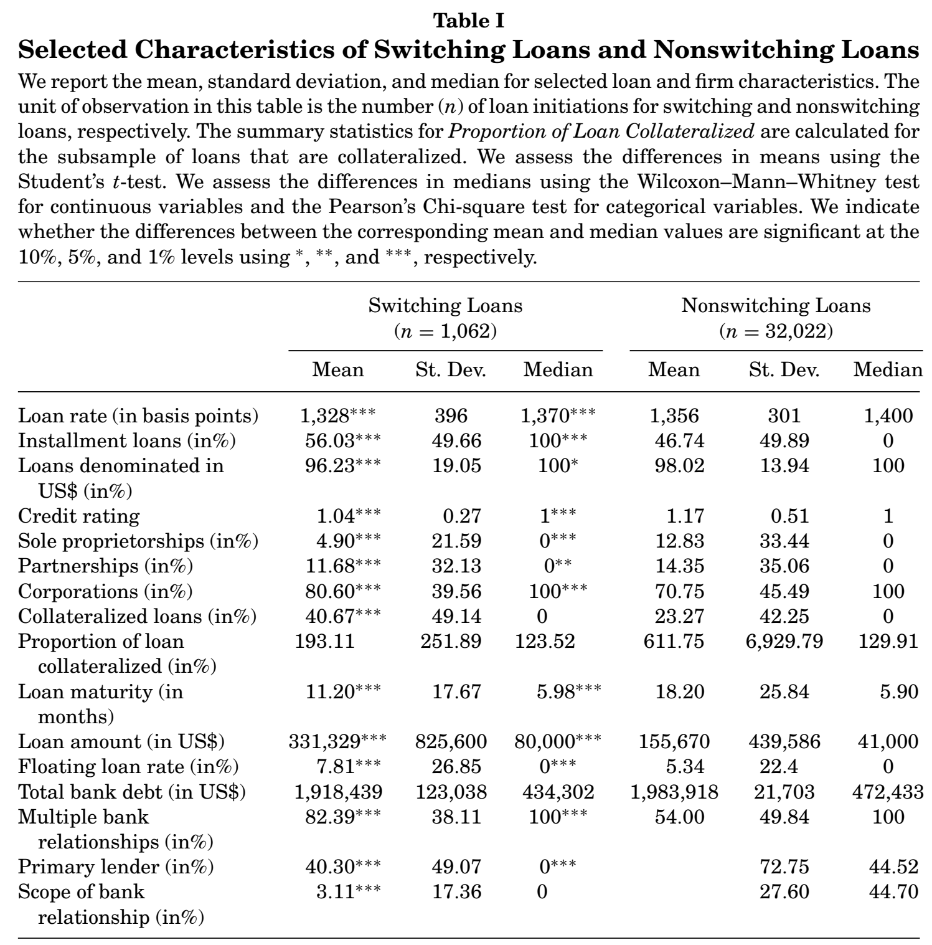

Slide 13
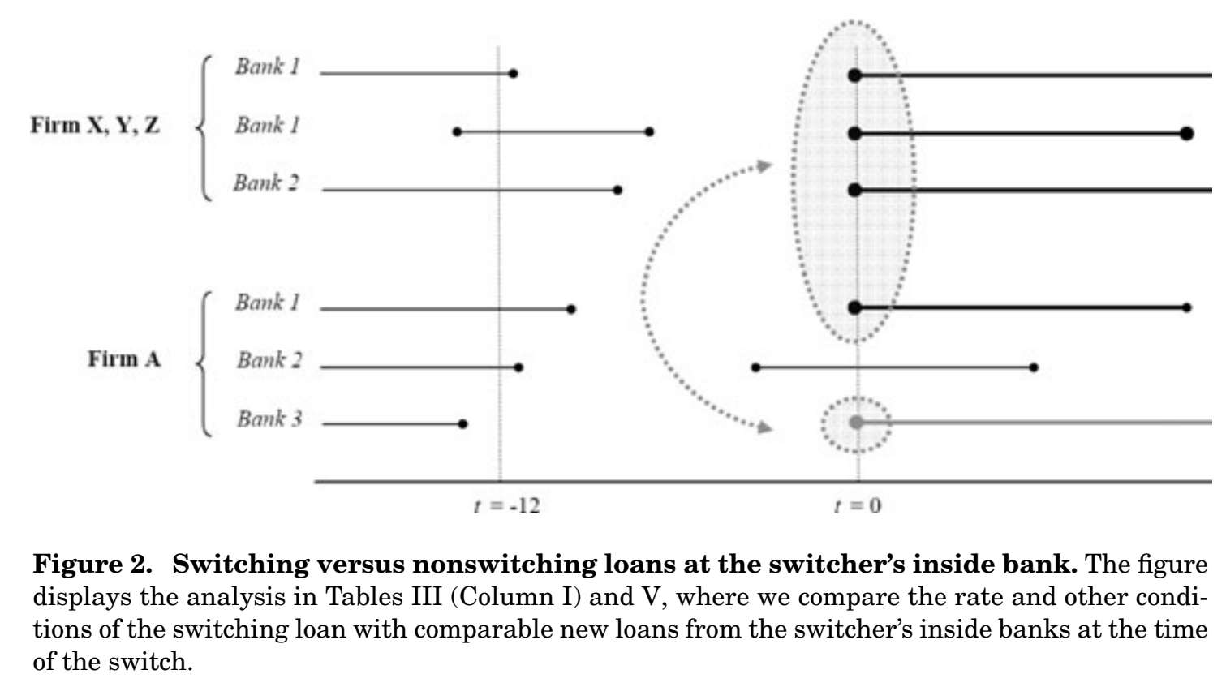
B.1. Matching
B.1. Matching

Slide 14
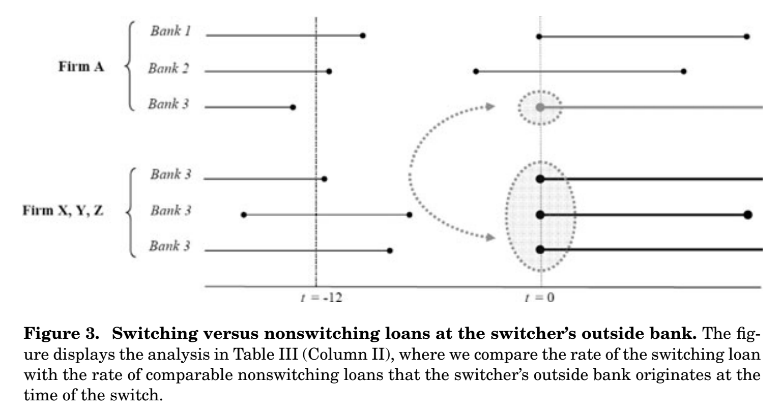
B.1. Matching
B.1. Matching

Slide 15
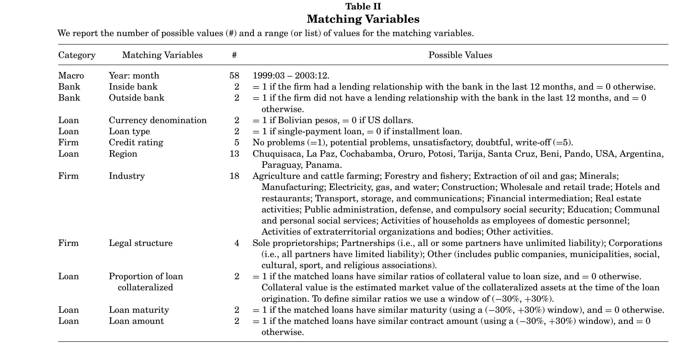

Slide 16
B.1. Matching
Testing strategy has three steps:
Matching
$r_{Switch}−r_{Not−switch}$
$r_{Switch}−r_{Not−switch}=α+ζ$
B.1. Matching

Slide 17
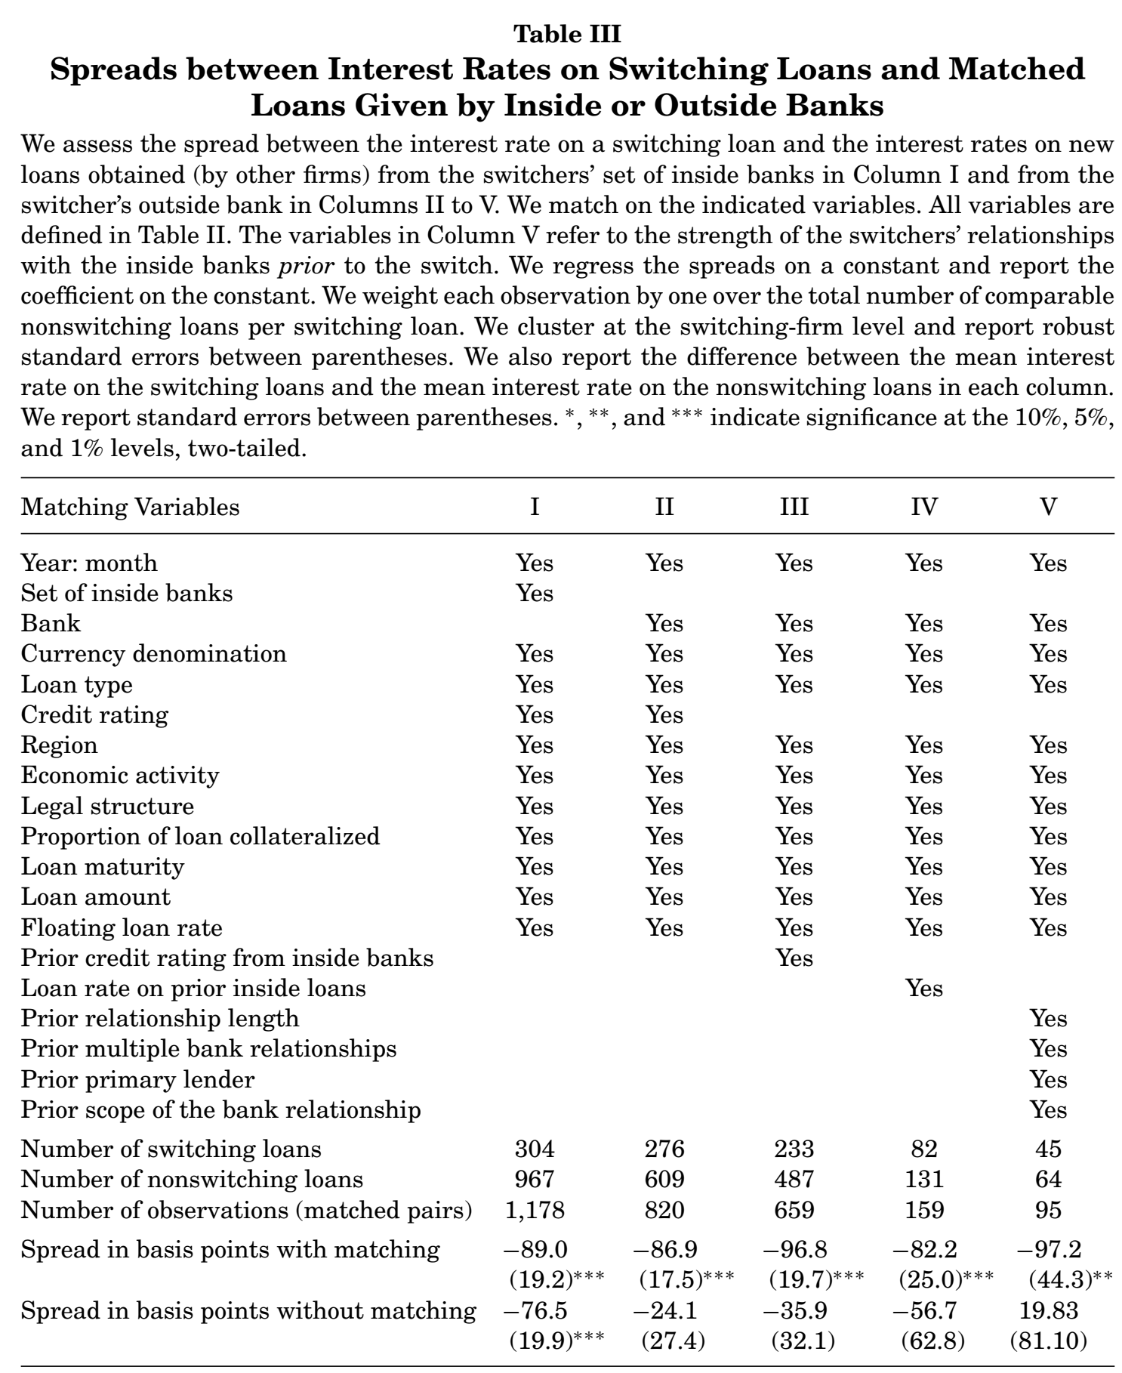
B.2. Switching Loans Matched with Loans from Inside or Outside Banks
B.2.1. Main Results.
B.2.2. Robustness Analysis.
B.2.3. Hold-Up and Alternative Explanations.
the average loan rate during
the sample period is 13.56%

Slide 18
(i) Hold-up problem(Column V of Table III )：
$$r_{Switch}−r_{Not−switch}=α+β∗X+ζ$$
X is equal to Prior Relationship Length,
$\hat{α}$ = 36.80(30.98), $\hat{β}$ = −6.55∗∗∗(1.71)
X is equal to Prior Multiple Relationships,
$\hat{α}$ = −71.76∗∗(32.46),$\hat{β}$ = 72.40∗(42.58)
X is equal to Scope of the Bank Relationship ,
$\hat{α}$ = −53.25∗∗∗(32.46) and $\hat{β}$ = −46.75(74.51).
X is Prior Primary Lender , it is equal to one for 99% of the observations in this matched sample.
(ii) Market concentration :
X is equal to the HHI of outstanding loans at the regional level ,
$\hat{α}$ = -103.20∗∗∗(22.11) ,$\hat{β}$ = 85.75∗∗(33.92).
B.2. Switching Loans Matched with Loans from Inside or Outside Banks
B.2.1. Main Results.
B.2.2. Robustness Analysis.
B.2.3. Hold-Up and Alternative Explanations.

Slide 19
Apart from matching on bank and borrower identity, we also match on all other variables of our benchmark model, which include credit rating and other loan conditions :353 switching loans to 246 firms and 1,430 comparable future loans (More than 98% of these loans have the best rating;the rest obtain the second best.).
group the corresponding matches in 6-month periods (“1 to 6 months” to “At least 37 months”) after the switch.
regress the spreads adjusted by the interbank market rate on the 6-month period dummies.
C. Loan Rates after Switching from the Outside Banks
C.1. Main Results and Robustness Analysis
C.2. Hold-Up and Alternative Explanations
C.3. Other Loan Conditions

Slide 20
C. Loan Rates after Switching from the Outside Banks
C.1. Main Results and Robustness Analysis
C.2. Hold-Up and Alternative Explanations
C.3. Other Loan Conditions
loan rate cycle

Slide 21
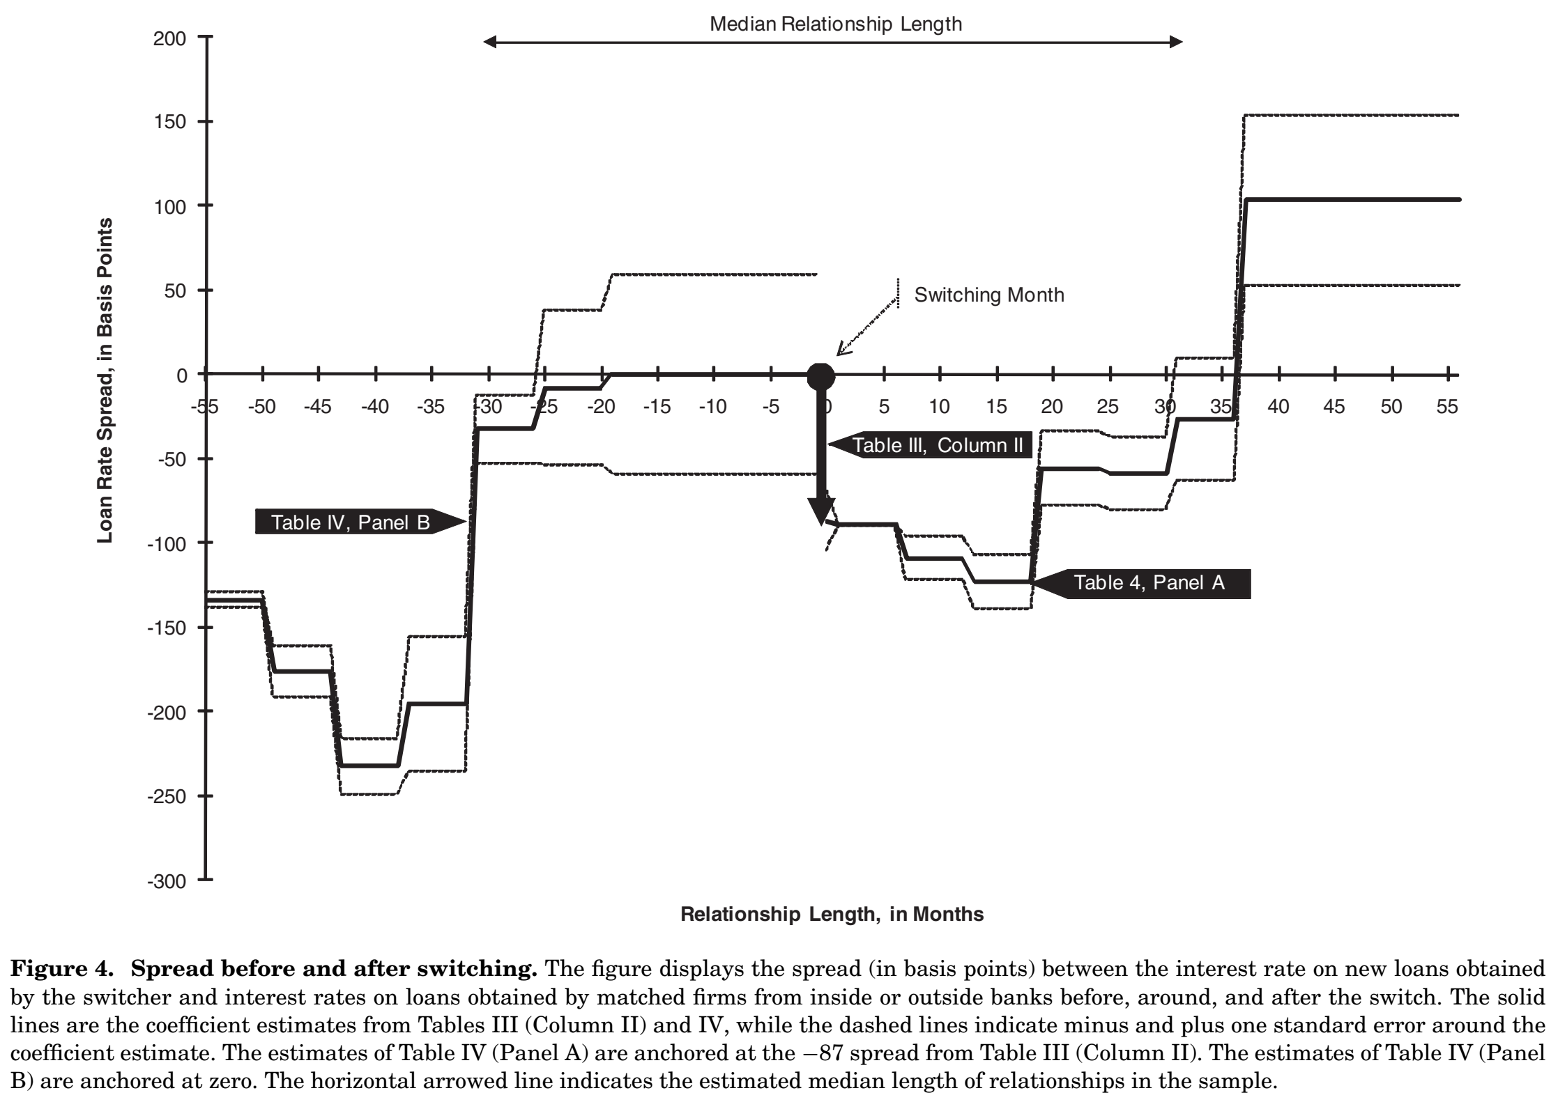

Slide 22
The effect of a number of key variables on the loan rate dynamics :
$r_{Switch}−r_{Not−switch}=α+β∗X+γ_{1}∗T+γ_{2}∗T^{2}+δ_{1}∗X∗T+δ_{2}∗X∗T^{2}+ζ$,
where X is a measure of relationship strength or the degree of local market concentration,T is the time in months since the switch.
when X is equal to Multiple Bank Relationships, the estimated coefficients suggest that maintaining multiple relationships softens (but does not eliminate) hold-up ( $\hat{γ_{1}}$= -8.98∗∗∗, $\hat{γ_{2}}$= 0.32∗∗∗, $\hat{δ_{1}}$= 7.02∗, and $\hat{δ_{2}}$= -0.18∗∗, with $\hat{γ_{1}}$+ $\hat{δ_{1}}$= -1.96 and $\hat{γ_{2}}$+ $\hat{δ_{2}}$= 0.14∗∗).
When X is equal to Scope of the Bank Relationship or Primary Lender, the estimated coefficients on the interaction terms do have the expected signs, but they are not statistically significant.
When X equal to HHI , the cycle is less pronounced in more concentrated markets ($\hat{γ_{1}}$= -25.43∗∗∗, $\hat{γ_{2}}$= 0.80∗∗∗, $\hat{δ_{1}}$= 132.22∗∗∗, and $\hat{δ_{2}}$= -3.81∗∗).
C. Loan Rates after Switching from the Outside Banks
C.1. Main Results and Robustness Analysis
C.2. Hold-Up and Alternative Explanations
C.3. Other Loan Conditions

Slide 23
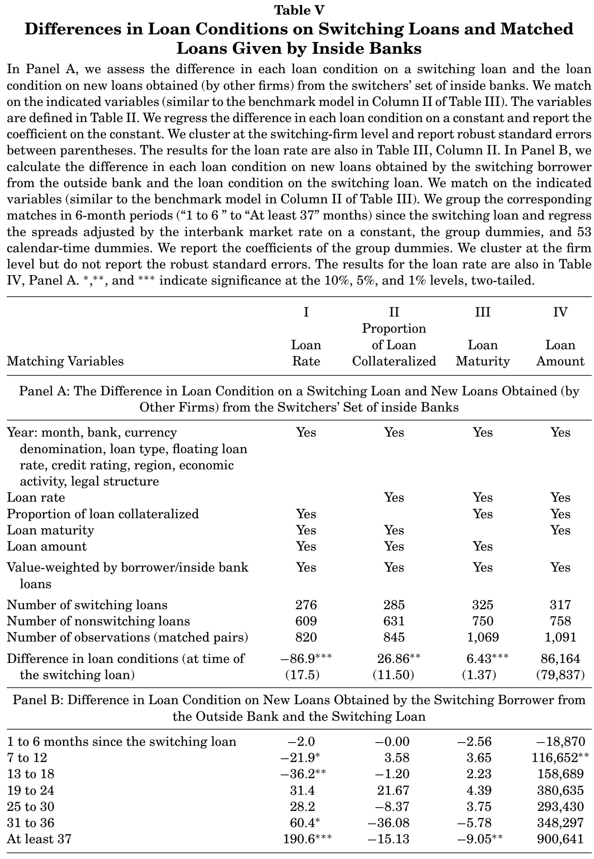
C. Loan Rates after Switching from the Outside Banks
C.1. Main Results and Robustness Analysis
C.2. Hold-Up and Alternative Explanations
C.3. Other Loan Conditions
VS Table III
VS Table IV,Panel A
Mitigate ex ante information asymmetries

Slide 24
H4 posits that (because of adverse selection) a larger proportion of switching firms is worse in terms of unobservable risk characteristics than a random draw of the population.
Comparing the entire population of switching and nonswitching firms.
Comparing a subsample of matched firms.
D. Adverse Selection: Loan Repayment and Information Sharing

Slide 25
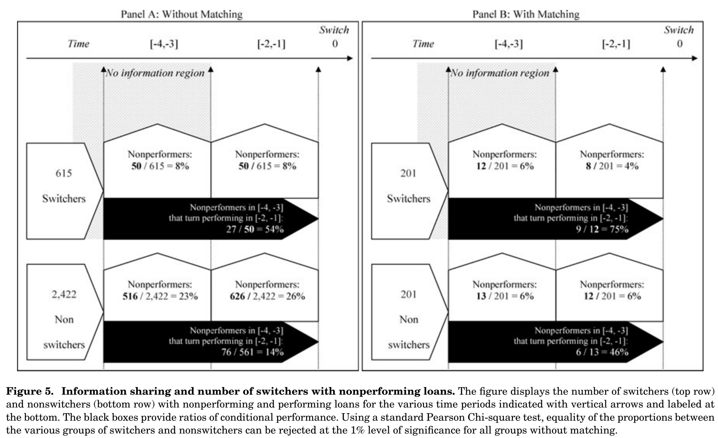
Compared to nonswitchers, a larger proportion of switchers has unobservable repayment problems.

Slide 26
IV. Conclusion
loan rate cycle
adverse selection

Slide 27
THANKS!

