Slide 1

Race-specific urban wage premia and the black-white wage gap
Author： Elizabeth Ananat , Fu Shihe , Stephen L. Ross
presenter：Fanrui
2018.12.07

Slide 2
C
ONTENT 目录
01
Introduction
02
Empirical Models
03
Worker Sample
04
Results
05
Conclusion

Slide 3
01
01
Introduction

Slide 4
Why is it important?
While a large literature documents the adverse outcomes experienced by African-Americans in the United States, this paper proposes a source of inequality between blacks and whites that has not previously been considered
identify a new correlate of the well-known black-white wage gap: the urban wage premium
we document that African-American males’ pay grows
more slowly with city size and employment density than does
white males’ pay
channel : find evidence suggestive of blacks receiving
lower returns from social networks than whites

Slide 5
Why is it important?
 ties a significant portion of the black-white wage gap to one of the central features of urban economies throughout the world: concentrations of economic activity increase productivity and wages, likely at least partly through the sharing of knowledge and the development of skills

Slide 6
What did this paper do and main finding
 across metropolitan
first look across metropolitan areas to document the relationship between wage differentials and two measures of urbanization: metropolitan area population and employment density for workplace Public Use Microdata Areas
These regressions indicate that a doubling of the
metropolitan area population is associated with between
a 0.7 and 1.0 percentage point increase in the black-white
wage gap and that a doubling of density is associated
with between a 1.2 and 1.4 percentage point increase

Slide 7
What did this paper do and main finding
 within metropolitan
we detect very similar effects when looking within rather than
across metropolitan areas.
restrict our sample to the 49 metropolitan statistical areas
(MSAs) with population of at least one million
then estimate individual wage equations on WP PUMA
employment density with MSA fixed effects separately
for each racial and ethnic group

Slide 8
What did this paper do and main finding
 find that blacks who work in a WP PUMA with higher employment density experience a smaller increase in wages than whites in the same metropolitan area. These models suggest that a one-standard-deviation increase in employment density is associated with an increase in the black-white wage gap of between 1.6 and 2.0 percentage points

Slide 9
What did this paper do and main finding
unobserved productivity
Then address concerns that the observed black-white
wage gap is in part attributable to worker unobservables
and that workers may sort into highdensity work locations
based on their unobserved productivity. we draw on
well established models of residential sorting that recognize
that observationally similar workers who sort into the
same residential neighborhood are likely similar on
their unobservables.

Slide 10
What did this paper do and main finding
These models conclude that comparisons of workers who live in the same neighborhood, but work in different locations within a metropolitan area, will reduce bias on unobservables relative to naïve comparisons across all workers in the metropolitan area

Slide 11
What did this paper do and main finding
estimate within-MSA wage models
We turn to the confidential files of the decennial census long form to estimate within-MSA wage models conditional on the census tract in which a worker lives.
Strikingly, while the inclusion of census tract fixed effects reduces the estimated black-white wage gap in our data by over half, from 15 to 7 percentage points, the standardized racial difference in the employment density wage premium barely changes, from 1.9 percentage points to 1.8 percentage points.
the racial difference in the estimated employment density wage premium for blacks is substantially larger than the difference in returns on any of the other observable demographic attributes

Slide 12
What did this paper do and main finding
mechanism
 race-specific information networks hypothesis (Hellerstein et al., 2011; Ionnides and Loury, 2004):
An important explanation for the urban wage premium is the sharing of information between firms(Ellison et al., 2010); if this sharing arises in part due to informal communication between workers at different firms, then lower levels of social interactions across race may reduce the returns to agglomeration

Slide 13
What did this paper do and main finding
Consistent with this hypothesis, we find that higher own-race representation in a local work area increases the wage premium associated with employment density. The black-white difference in exposure to workers of the same race explains 65% of the standardized effect of race on the return to employment density

Slide 14
02
02
Empirical models

Slide 15
examine across-MSA variation in the wage gap
Ways：use two-stage GLS
first stage : regress log wage on race
: log wage of worker i from s MSA
:indicator variable for whether worker i is black
:vector of individual worker attributes
second stage : regress on
where the inverse of the square of the standard error on
the estimate of is used as a weight in estimating
:the size of the metropolitan area

Slide 16
examine within-metropolitan area variation in wages
: log wage of worker i who works in location j from s
MSA and come from race group r
:employment density in each work location j within s MSA
:vector of individual worker attributes
:metropolitan area fixed effect
the resulting black-white difference in the observed wage premium is

Slide 17
2.1Worker productivity unobservables
concern 1: One potential explanation for our results is unobservable differences between the white and black workers in the same work location .
For example, if white workers sort into locations with high levels of economic activity more selectively based on ability than do black workers, then racial differences in ability will correlate with the level of economic activity.

Slide 18
2.1Worker productivity unobservables
address
 ways: implement the Fu and Ross (2013) strategy for reducing bias by comparing the wages of observationally equivalent individuals who reside in the same location.
 divide workers into cells based on their demographic attributes, including race, and then add demographic-cell-by-neighborhood fixed effects
 logic :similar individuals who observe the same residential opportunities within a metropolitan area and then make the same residential choices are likely to be relatively similar on unobservables

Slide 19
2.1Worker productivity unobservables
concern 2: A second potential reason for the observed racial differences in the return to employment density is that race may correlate with factors that offer a differential return to exposure to economic activity.

Slide 20
2.1Worker productivity unobservables
 address: allow the return to employment density to vary over key worker attributes
First, the return is allowed to vary by traditional demographic variables, such as education and family structure, that predict earnings and labor force participation
Second, whites and blacks may sort differentially into industries and occupations, and those different industries may experience different returns. Therefore, we include industry and occupation controls in the log wage equation, and also allow the return to employment density to vary across those industry and occupation categories.

Slide 21
2.1Worker productivity unobservables
In summary, we will estimate the next model:
i: individual worker
x:cell
t:residential location
j:working location
s:MSA
:demographics, such as education and family structure
:demographic cell-residential location fixed effect
：occupation

Slide 22
2.2. Race-Specific networks
 Recently, researchers have provided evidence that racial isolation and relationships between workers drive differences in labor market outcomes.
for example, Hellerstein et al. (2008) find that the benefit to an individual of nearby job locations depends heavily on whether members of one’s own race are employed there.

Slide 23
2.2. Race-Specific networks
A separate literature has documented that a major source of the urban wage premium is agglomeration economies arising from spillovers across individuals (Ellison et al., 2010), and researchers have further argued that these spillovers may take the form of peer and social interaction effects that arise in dense areas.
For example, Nanda and Sorenson (2010) find evidence of peer effects on self-employment that suggests knowledge- or experience-sharing between workers.

Slide 24
2.2. Race-Specific networks
We therefore investigate the possibility that our results may be in part driven by race-specific networks, by testing whether the race of the workers in the surrounding region affects the employment density wage premium. Such a finding would suggest that race-specific networks influence the returns to agglomeration economies, perhaps
through spillovers across individuals
:For each work location j, we calculate the fraction of workers in
that location who belong to the same racial group as individual i

Slide 25
03
Worker Sample
03

Slide 26
Worker Sample
Full sample: the Integrated Public Use Samples (IPUMS) from the Long Form of the 2000 U.S. Decennial Census
First subsample
A subsample of prime-age (30–59 years of age), full time, male workers is drawn for all Consolidated Metropolitan and Metropolitan Statistical Areas that have 200,000 or more residents.
These restrictions lead to a sample of 1,518,080 workers, including 1,086,760 white workers and 155,042 black workers
 second subsample
We also consider a second smaller sample of the 49 metropolitan areas with populations over 1 million,30–59 years of age, full time, male workers

Slide 27
Worker Sample
dependent variable :logarithm of the hourly wage
demographic controls : categorical variables by race and ethnicity, age, education, family structure, and immigration status. These categories are also used to create our observationally equivalent cells.
agglomeration: the logarithm of population at the metropolitan area level, and employment density in units of 1000 workers per square kilometer for each WP PUMA.

Slide 28
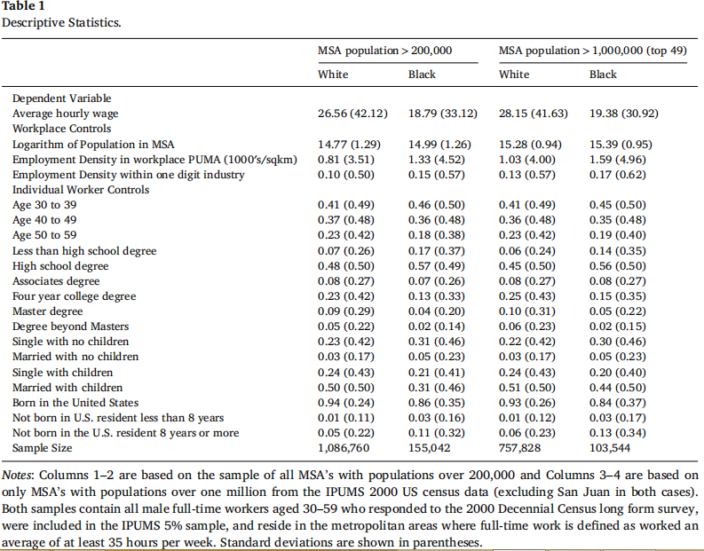
Worker Sample
summary statistics

Slide 29
04
Results
04

Slide 30
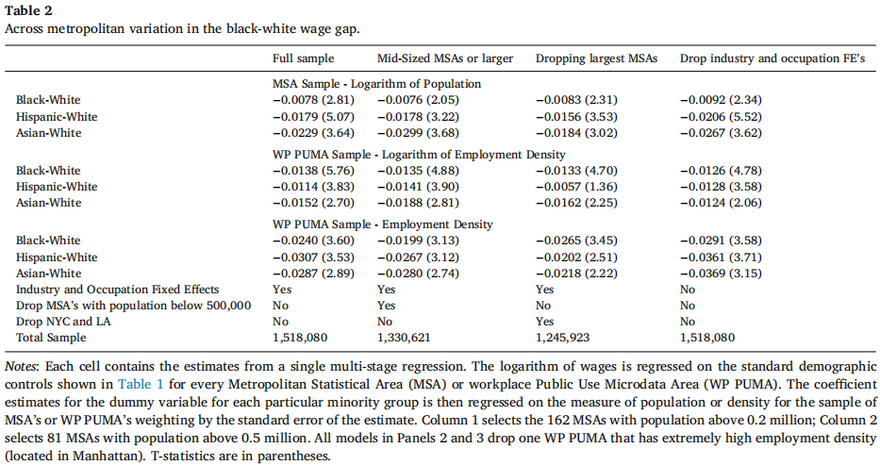
two-stage estimates of the across-metropolitan area gaps

Slide 31
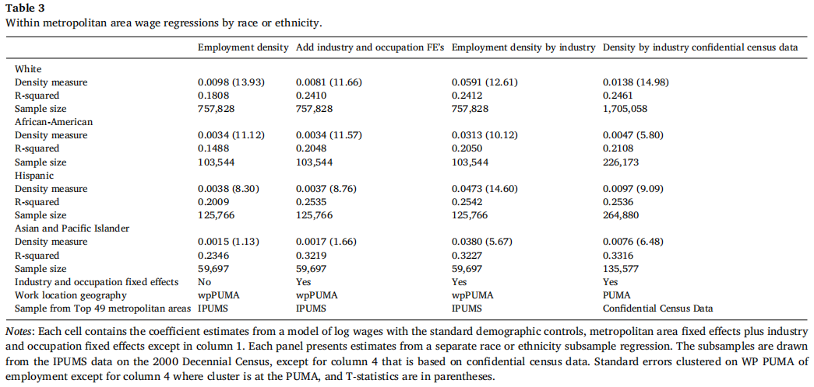
within-MSA variation in the wage premium associated with high employment density

Slide 32
4.1. Proxy for unobservable ability and allowing for heterogeneous returns to density
As discussed above, we prefer models based on within-metropolitan area variation in work location because we believe using within-metro variation helps alleviate concerns about sorting on unobservables between cities. While concerns might remain about endogenous worker sorting across work locations within metropolitan area.

Slide 33
4.1. Proxy for unobservable ability and allowing for heterogeneous returns to density
 Three evidence
First, we note that black workers do not systematically sort into high- or low-employment-density work locations relative to other workers in general or relative to the subsample of white workers.

Slide 34
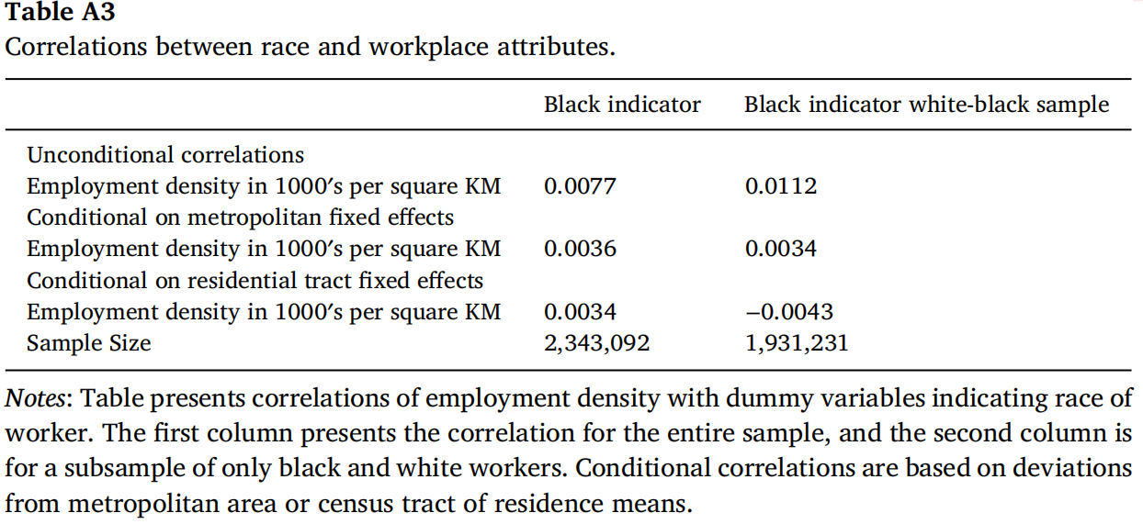
4.1. Proxy for unobservable ability and allowing for heterogeneous returns to density
correlations of employment density with dummy variables indicating race of worker.

Slide 35
4.1. Proxy for unobservable ability and allowing for heterogeneous returns to density
 Three evidence
Second, we note that Fu and Ross (2013) find at most a very small correlation between residential PUMA employment density and whether a worker has a high school or college degree. That is, workers do not appear to be systematically sorting over work locations within metropolitan areas either based on race or based on observable measures of human capital.
Third, we show that while our residential location fixed effects substantially reduce the estimated black-white wage gap, suggesting that they proxy for unobserved productivity correlated with race, these controls have virtually no impact on the estimated black-white gap in the employment density wage premium.

Slide 36
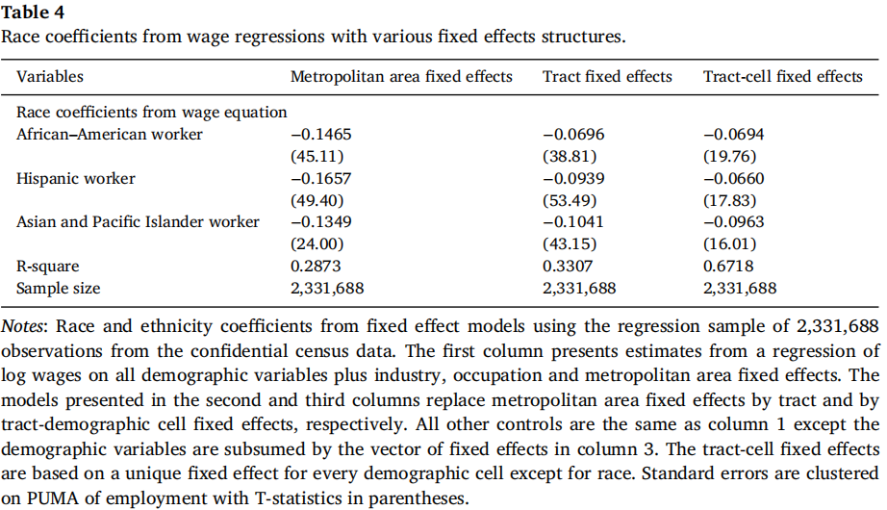
4.1. Proxy for unobservable ability and allowing for heterogeneous returns to density

Slide 37
4.1. Proxy for unobservable ability and allowing for heterogeneous returns to density
 Specifically, we document that the estimated effect of employment density on the black-white wage gap is very robust in terms of magnitude to the inclusion of census tract by demographic cell fixed effects
First, Column 4 of Table 3 repeats the analysis presented in Column 3 of Table 3 by estimating a simple log wage model conditional on metropolitan area fixed effects separately for each racial subgroup of workers, using the confidential version of the census long form data. The difference between the white and black estimates, 0.0091, implies that a one-standard-deviation change in employment density is associated with a 1.9% increase in the black-white wage gap.

Slide 38
4.1. Proxy for unobservable ability and allowing for heterogeneous returns to density
Specifically, we document that the estimated effect of employment density on the black-white wage gap is very robust in terms of magnitude to the inclusion of census tract by demographic cell fixed effects
Next, Table 5 presents estimates of the interaction between employment density and worker demographics based on the model described by :

Slide 39
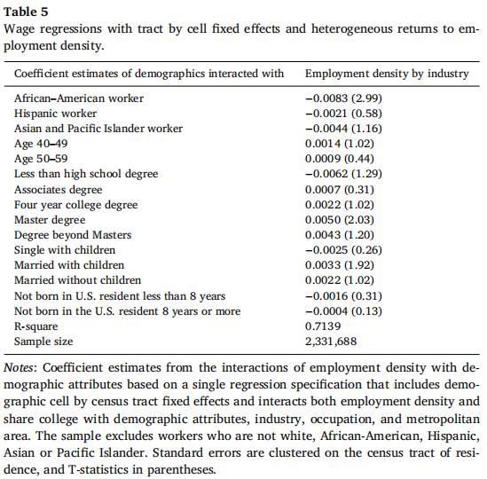
4.1. Proxy for unobservable ability and allowing for heterogeneous returns to density

Slide 40
4.1. Proxy for unobservable ability and allowing for heterogeneous returns to density
Our finding that black workers experience a lower return to employment density than otherwise similar white workers is very robust to both proxies for potential unobserved racial differences in ability and to allowing the employment density wage premium to be heterogeneous across a variety of characteristics.

Slide 41
4.1. Proxy for unobservable ability and allowing for heterogeneous returns to density
In fact, the black-white difference in the return to employment density is larger than the coefficient on any other demographic interaction with density. Most of the other demographic interactions are insignificant, and the two largest—the effect of graduate level education relative to a high school graduation and the effect of being married—are only 60% and 40% the size of the effect of being black on the employment density wage premium, respectively. By contrast, when modeling wages rather than returns to density, race matters much less than other demographics: wages are 14–15% lower for blacks than whites, while they are 37–50% higher for those with graduate degrees than those with high school diploma, and 20% higher for those who are married (see Appendix Table A2)

Slide 42
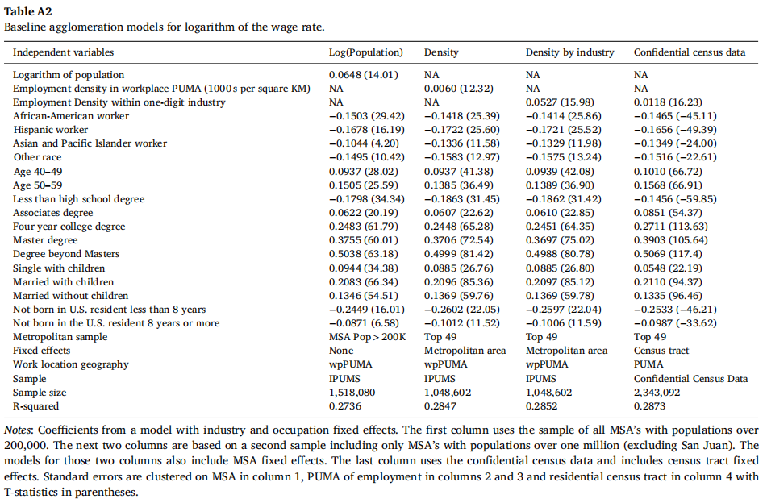
4.1. Proxy for unobservable ability and allowing for heterogeneous returns to density

Slide 43
4.2. Heterogeneity in effects across work locations
Question: why race might have such a strong impact on the employment density wag premium, while other salient demographics do not.
hypothesis: social networks within the local work area may serve as a potential mechanism behind our findings, since race plays such a significant role in the formation of social relationships (Davis et al., 2016; Fletcher et al., 2013), including at work (Ananat et al., 2013).
Specifically, we hypothesize that minorities may be disadvantaged because they lack same-race peers in the area where they work

Slide 44
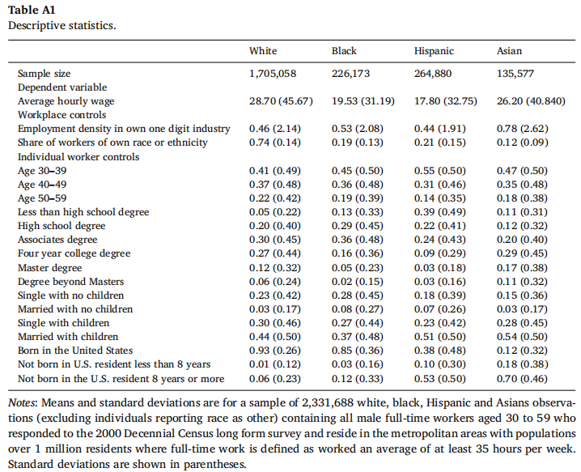
4.2. Heterogeneity in effects across work locations
Evidence
evidence 1:simple descriptive statistics

Slide 45
4.2. Heterogeneity in effects across work locations
evidence 2: run a regression
interact employment density with same-race exposure, i.e. share of all workers in the work area (defined by residential PUMA) who have the same racial or ethnic classification as the worker himself. Essentially, we run a horse race between an individual’s race and the share own-race workers in the residential PUMA where the individual works, to measure which has a stronger interaction with employment density. These regressions indicate whether the employment density wage premium differs by race generally, or rather, primarily when black workers have very few same-race workers in the vicinity

Slide 46
4.2. Heterogeneity in effects across work locations
evidence 2: run a regression
The interactions with share same-race are positive and highly significant, consistent with own-race workplace networks as a conduit for receiving returns to agglomeration. In fact, the magnitudes of the coefficients on these variables suggest that exposure to others of the same race could be a very important conduit.

Slide 47
4.2. Heterogeneity in effects across work locations
evidence 2: run a regression
The positive coefficient on the black interaction with employment density would seem at first glance to imply that, after controlling for own race, returns to agglomeration are larger for blacks. However, the estimated coefficient on black in Table 6 is conditional on holding own race share in workplace fixed, while the effect of being black rather than white in a given work location is actually the black coefficient plus the product of [(the own-race share coefficient) ∗ (the difference between the share of black workers and white workers)].The resulting net race coefficient at the mean difference in own race exposure is (0.014+0.0537∗(0.195–0.740)), or −0.015, very similar to our estimate of the black-white difference in return to density

Slide 48
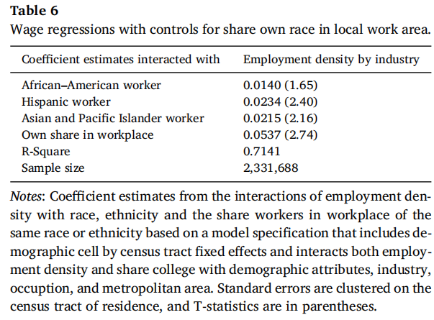
4.2. Heterogeneity in effects across work locations
Evidence
evidence2:run a regression

Slide 49
05
Conclusion
05

Slide 50
conclusion
This paper demonstrates that blacks receive significantly lower urban population and employment density wage premia than whites
The employment density results hold when comparing workers across metropolitan areas, within metropolitan areas, and even when comparing workers who have demonstrated their similarity to each other by selecting into the same residential neighborhood.
While we cannot provide causal evidence that the return to agglomeration differs by race, several pieces of evidence suggest that the black disadvantage in the employment density wage premium is not driven by racial differences in how workers sort across local work areas
Finally, we show that the employment density wage premium increases as the fraction of workers in the local area who share an individual worker’s race increases.

Slide 51
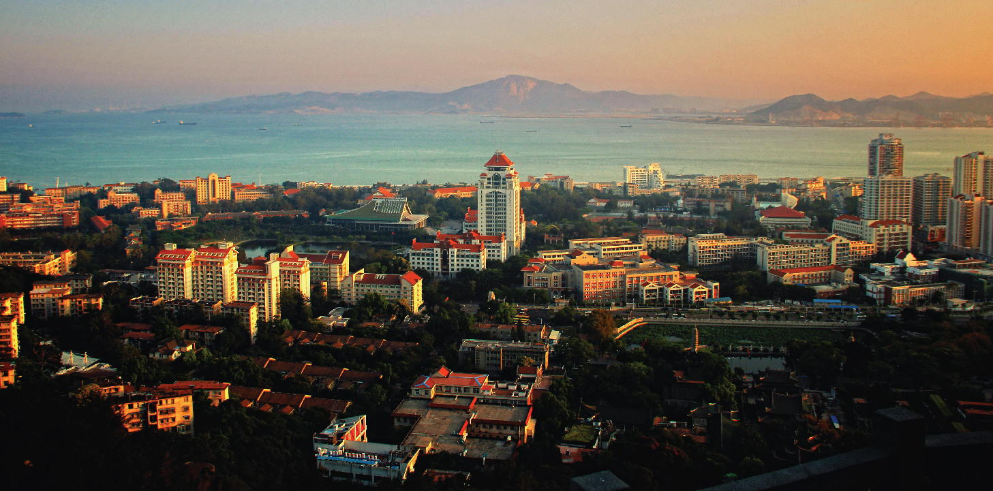
THANK YOU !
2018.12.07

