Slide 1

Social identity and inequality: The impact of China's hukou system
Author： Farzana Afridi, Sherry Xin Li , Yufei Ren
Reporter：Rui Fan
Date: 2018.11.08

Slide 2
C
ONTENT
01
Introduction
02
Literature
03
The Hukou System and Social Identity in China
04
Experimental Design
05
Results
06
Discussion
07
Conclusion and My Thinking

Slide 3
01
01
Introduction

Slide 4
Introduction
A large body of literature documents significant and increasing economic inequality in the emerging economies of the world. Akerlof and Kranton (2000) incorporate individuals' social identity into a theoretical model of poverty and show that social exclusion can lead to equilibria in which the ‘excluded’ individuals avoid economic activities that are remunerative.
This paper extends the literature on social identity. We design a framed field experiment (Harrison and List, 2004) to study whether individuals' identities created by hukou system affect their performance and distribution of earnings among these different socio-economic groups under incentives.

Slide 5
Introduction
To introduce an exogenous variation in identity salience , we adopt a methodology from psychology called priming (Bargh, 2006).
we randomly assign primary school students in Beijing with different hukou backgrounds to two treatments. In the identity salience treatment(treatment group) we prime students' hukou identity and make it salient through a pre-experiment questionnaire followed by a public verification of their hukou status (Shih et al., 1999; Hoff and Pandey, 2006, 2014). In the control group, students' hukou identity is kept private. We then study the causal impact of hukou identity salience by using a difference-in-difference approach. That means comparing the difference in the performance of local urban students and students from rural migrant families between the two group.

Slide 6
Introduction
Our results show that when hukou identity is made salient, the migrant students performed worse by 0.88 mazes relative to the local urban subjects
in the overall sample, and by 1.241 mazes under piece rate payments. In addition, migrant students' average ranking of experimental earnings declines by 13.5 percentiles relative to local urban students under piece rate payments. however, these effects are insignificant under the tournament regime, suggesting that competition may reduce the negative effect of the salience of migrants' inferior identity.

Slide 7
02
02
Literature

Slide 8
Literature
The importance of incorporating social identity into economic analyses is stressed by Akerlof and Kranton (2000).
only two studies investigate the impact of social identity on economic outcomes in developing countries experimentally. Hoff and Pandey (2006, 2014) find that social identity — a product of history and culture — shapes one's belief system and has a pronounced impact on an individual's performance under incentives. They show that making caste salient to middle school male students in rural India lowers the performance of low-castes relative to high-castes even when rewards for performance depend solely on individual effort. Hoff and Stiglitz (2010) discuss why ideologies of social unworthiness can be so powerful.

Slide 9
Literature
Concerns about rising inequality accompanying rapid economic growth have been growing in recent years. Research suggests that on average those with a rural hukou are socio-economically worse-off than those with an urban hukou in China. However, due to confounding unobservable individual characteristics, causality between self-perceptions of hukou status and economic behavior is hard to establish using survey data or direct field observations. Hence, the current literature almost entirely focuses on restricted labor mobility and discrimination in resource allocation in the hukou system to explain rural–urban inequality (Liu, 2005; Lu and Song, 2006; Whalley and Zhang, 2007).

Slide 10
03
The hukou system and social identity in China
03

Slide 11
The hukou system and social identity in China
The modern-day hukou system evolved gradually following the founding of New China in 1949. Strict controls were imposed on mobility of rural hukou holders to urban areas. And there exists discrimination against them in several ways such as employment opportunities, ration stamps institution, housing, health services and education and so on.
Following China's reform and opening-up in 1978, the number of people migrating in search of jobs surged due to market reforms and an easing of government regulations on spatial migration. However, these migrants are not entitled to urban benefits unless. Rural–urban hukou conversion is possible but only through very limited channels. Thus the hukou system transitioned from an institution of direct to indirect control over spatial migration.

Slide 12
The hukou system and social identity in China
Chinese citizens are entitled to public education only in the area of their legal permanent residency. In most cities non-local hukou holders cannot enroll their children in local schools unless the schools have quotas for ‘guest’ students. These ‘guests’ usually have to pay higher fees than local hukou holders. Slum schools built by migrant workers for their children are typically opposed by local authorities and the quality may not be as good as local public school.

Slide 13
The hukou system and social identity in China
During China's urbanization process, the newly developed urban areas contain both non-agricultural and agricultural populations (Chan and Zhang, 1999). Thus the population in large cities such as Beijing and Shanghai usually consists of four different hukou type: local urban, non-local urban , local rural ,and non-local rural hukou holders.
The local urban residents are considered to be at the top of the social hierarchy while the migrants from rural areas are typically at the bottom. But
the comparison of socio-economic status between local rural and nonlocal urban is not clear. Due to this and the limited number of students in these two type in our sampled schools, we excluded the local rural and non-local urban hukou holders ,and focused on the two sharply disparate groups. Since our experiment was conducted in Beijing, this study includes Beijing urban (H type) and non-Beijing, rural (L type) hukou holders.

Slide 14
04
Experimental Design
04

Slide 15
Experimental Design
Our experiment adopts the design of Hoff and Pandey (2006, 2014).We manipulate hukou salience — subjects' hukou identity is made salient and public in the treatment group and is kept private in the control group. We also vary the payment regime by using piece rate and tournament in each of the group.

Slide 16
Experimental Design
● Incentivized cognitive task
The experiment was conducted using paper and pencil in a standard classroom setting with six subjects (3 H and 3 L types). Randomly assigned
subject ID numbers were used to ensure anonymity of decisions throughout
the experiment.
Before the experiment started participants were greeted by a female experimenter and each paid 3 Chinese yuan (¥3) participation fee upon arrival.
The experimenter then explained the tasks and rules. We used level-2 maze puzzles from Yahoo. The subjects were given 5 min to practice with an additional maze, and then they participated in two 15-minute rounds of experiment. In each round, they were given a booklet of 15 mazes, All thirty mazes were of identical difficulty level.

Slide 17
Experimental Design
● Incentivized cognitive task
◎homogeneous reward system vs heterogeneous reward system
homogeneous reward system: the Pure Piece Rate (PP) treatment.
It used piece rate compensation in both rounds — the subjects were rewarded with ¥1 for each maze solved correctly.
heterogeneous reward system: the Mixed Tournament (PT) treatment.
.It consisted of piece rate in the first round (¥1 per maze), and tournament in the second round in which only the winner (who solved the most number of mazes in the session) was rewarded with ¥6 per maze and other subjects received zero.

Slide 18
Experimental Design
● Incentivized cognitive task
The subjects were told that the task consisted of two rounds. But the
instruction for the second round, including the payment scheme, was
not given until after round one.
At the end of each round, maze booklets were collected and left outside
the classroom by the experimenter for the graders. A survey was conducted at the end to collect demographic information. Then, the grading results were left outside the classroom and picked up by the experimenters. The subjects were then informed about their performance, paid individually in private, and dismissed. Throughout the process, neither the subjects could see the graders nor the graders could associate the booklets with individual subjects.

Slide 19
Experimental Design
● Identity manipulation
There were two treatments in our experiment — the identity salience treatment and the control treatment. The identity salience treatment differs from the control treatment by manipulating the salience of one's hukou identity before the incentivized tasks by using Priming.
Priming, a technique often used in psychology, introduces certain stimuli (‘primes’, including image, audio, or text such as a questionnaire and an article) to activate the subjects' knowledge of social structures. As shown in a large literature in psychology (see Bargh, 2006 for a review) and a few recent economic studies (Hoff and Pandey, 2006, 2014; Benjamin et al., 2010, 2013; Chen et al., 2014), priming social identities may influence behavior and attitudes.

Slide 20
Experimental Design
● Identity manipulation
In this study, we made hukou identity salient in the identity treatment by using a survey and publicly verifying the subjects' hukou identity at the beginning of the experiment, while in the control treatment the subjects' hukou identity was kept private and not primed.
◦ pre-experiment survey
In the pre-experiment survey, the subjects were asked where they were born, whether they spoke Beijing dialect at home, whether they (their classmates or teachers) considered themselves (them) as a Beijing local, and how much miscellaneous fees they were charged by the school at the beginning of the semester.
◦public verification
After the survey, individuals' hukou was publicly verified by the experimenter in the following order: name, date and month of birth, and hukou.

Slide 21
Experimental Design
● Selection of subjects
The subjects in our experiment were 8–12 years old students, randomly selected from four elementary public schools in Beijing. These schools suited the requirements of our experiment on several ways. On average, one-third of enrolled students in the sampled schools had a non-Beijing hukou. The proportion of students from migrant families was comparable to the migrant population of the Beijing urban area, and these schools were located in districts where per capita GDP was comparable to the average in the Beijing urban area.

Slide 22
Experimental Design
● Selection of subjects
The subjects were randomly selected from among 3–6 graders at
three schools and among 3–5 graders in one. Each session of the experiment consisted of 6 subjects of the same gender with three from each of the H and L hukou types. The sessions in treatment group and control group were formed in the same way.

Slide 23
Experimental Design
● Selection of subjects
To minimize the probability that students knew one another a priori, we designed and implemented the following procedure to randomly select and assign students to the experimental sessions. Female sessions are used as an example to illustrate the procedure here. Male sessions were formed in the same way.
a. We stratified students by gender, grade, class section, and hukou type.
b. For mixed-HL female sessions, we randomly selected three female students of one hukou type, each from a different grade.

Slide 24
Experimental Design
● Selection of subjects
c. We repeated step b for the other hukou type.
d. To minimize the chance that the six selected students in steps b and c knew one another, we checked whether the two students selected from the same grade belonged to the same class section. If yes, we replaced one student (randomly selected) with another randomly selected student (of the same hukou type and gender) from a different class section in the same grade. If not, the initial selection of six students was randomly assigned to one experimental treatment.
e. We repeated the above steps to fill all prescheduled sessions at each school.

Slide 25
Experimental Design
● Selection of subjects
The experiment was conducted in May and December 2007, and December 2008. At each school the experiment included four treatments including the PP and PT control treatments as well as the PP and PT identity salience treatments. In total, we conducted 72 sessions (418 subjects) with mixed hukou types, including 61 full sessions (40 male and 21 female sessions with 3H and 3L subjects each) and 11 sessions with fewer than 6 subjects.

Slide 26
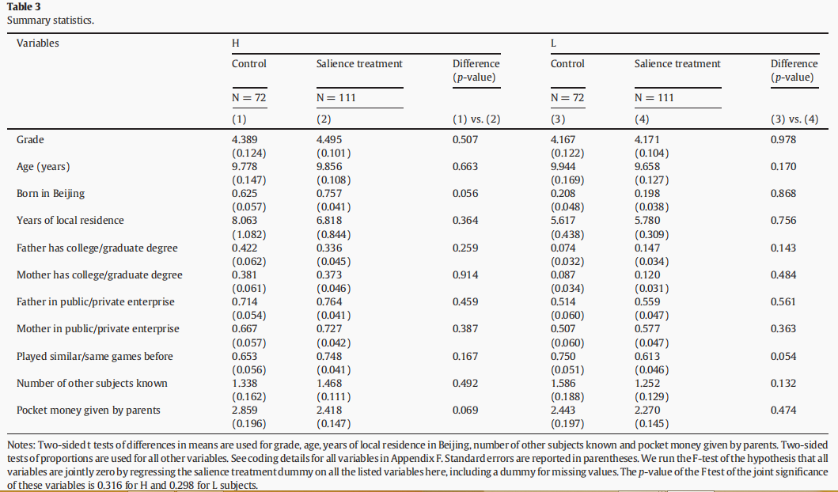
Experimental Design
● Selection of subjects

Slide 27
Experimental Design
● Selection of subjects
Table 3 presents the subjects' characteristics by hukou type and treatment. For each hukou type it shows insignificant differences across treatment in almost all observable characteristics. This indicates successful randomization of the subjects across treatment.

Slide 28
05
05
Results

Slide 29
Results
In this section, we study whether and how the activation of hukou identity salience influences individual's performance in the maze games. We have 366 subjects in our sample.
In the analyses, we first show results by pooling the data across payment methods and gender groups. We then split the sample on one dimension, either by payment or gender. We further split the sample on two dimensions, by payment and gender group.

Slide 30
Results
our discussion of results will focus on the differential effect of the experimental treatment on the L and H subjects, i.e., the difference-in-difference estimates.

Slide 31
Results
● the impact of hukou salience on individual performance
school fixed-effects model:
:the number of mazes solved by individual i in school s.
:dummy variables for the identity salience treatment
:dummy variables for low hukou type
: control variables
:School fixed effects

Slide 32
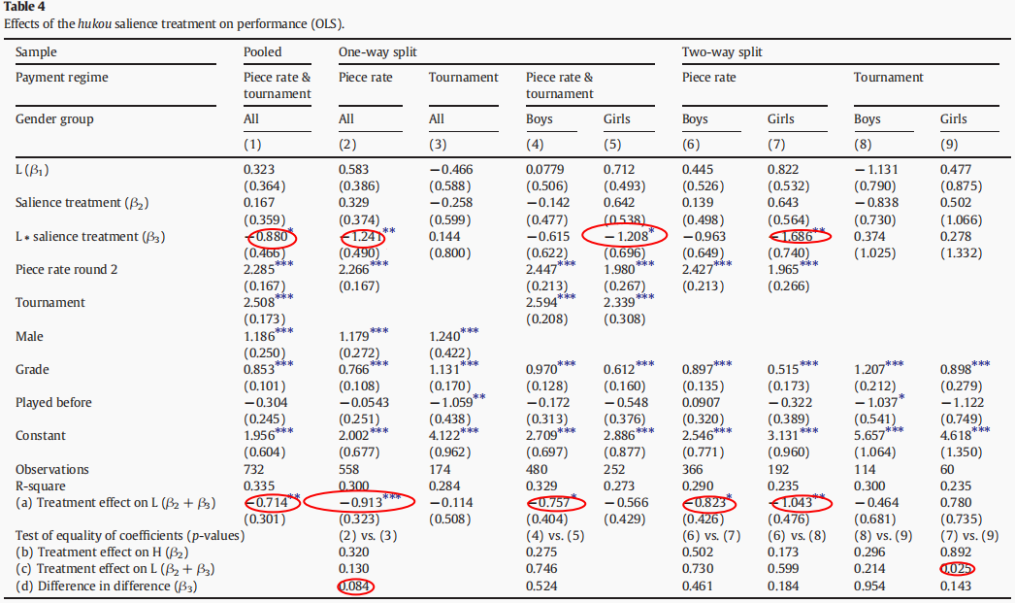
Results
Table 4 focuses on individual performance in the maze game.

Slide 33
Results
Our results in table 4 show that when hukou identity is made salient, the migrant students performed worse by 0.88 mazes relative to the local urban subjects in the overall sample, and by 1.241 mazes under piece rate payments ,while this negative impact is absent in the tournament regime. This implies that making one's hukou identity salient may influence individual's performance on incentivized tasks depending on the payment scheme.

Slide 34
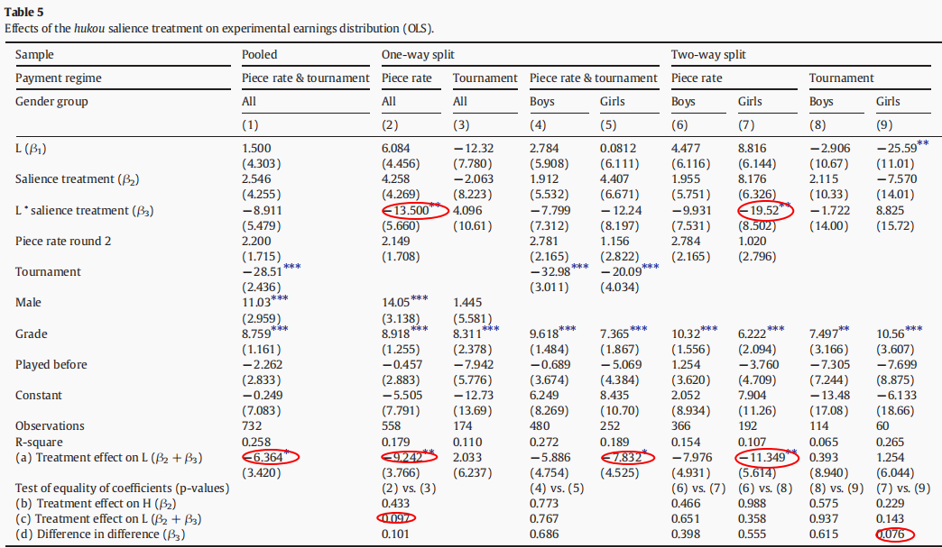
Results
What is the impact regarding the experiment income distribution for
different hukou groups?(table 5)

Slide 35
Results
Overall, the results in Table 5 indicate that making hukou identity salient significantly decreases the L type's average ranking in the earnings distribution relative to H's in the piece rate regime, but the impact is again absent in tournament. These findings further confirm the previous results on individuals' performance.

Slide 36
06
Discussion
06

Slide 37
Discussion
Question 1:
the results in table 4 and table 5 indicate that making hukou identity salient reduces L's performance as well as average ranking in the earnings distribution relative to H's significantly in the pooled sample and piece rate regime. But why ?
Potential ANS:
stereotype threat and the intimidation effect

Slide 38
Discussion
●stereotype threat
◎Stereotype threat is a well-established finding in social psychology and recently formalized in an economic model by Dee (2014). The stereotype threat literature in psychology shows that making social identity salient in the laboratory often makes the subjects behave consistently with the stereotypes associated with that social group, and hence may activate the negative stereotypes and hurt the subjects' performance in relevant tasks.
◎In China， rural migrants are generally stereotyped to be “uneducated, dirty and having higher propensities to be criminals” (Wang and Zuo, 1999). Migrant children are stereotyped to be less intelligent and have low academic achievement. This self-image may be activated for migrant students following the priming of their inferior hukou background in this study, and may prevent them from performing to their full potential in the assigned tasks even in the presence of economic incentives.

Slide 39
Discussion
● the intimidation effect
There is another possible explanation for the identity impact we observe: the intimidation effect (Hoff and Pandey, 2006, 2014), i.e., knowing that they are evaluated along with H type counterparts may hurt L type students' self confidence in the identity salience treatment.

Slide 40
Discussion
● the intimidation effect
To see whether there exists intimidation effect, we compare L‘s performance in the presence of H with that in the absence of H . We conducted four pure L hukou sessions with the PT identity salience treatment. If a public announcement of hukou type in the presence of H type truly intimidated the L type, then the performance of the L subjects in the mixed-hukou sessions would have been worse relative to their performance in the pure-hukou sessions. However, as shown in Table A8 of Appendix G, in both rounds of the PT salience treatment we find no significant differences in the performance of the L subjects (girls, boys or pooled) between the mixed and pure-hukou sessions. We, therefore, conclude that our results are unlikely to be explained by an intimidation effect.

Slide 41
Discussion
Question 2:
Recall the difference-in-difference estimates β3 in Tables 4 and 5 which show that making hukou identities salient results in a significant decrease in the L type's relative performance and their relative ranking in the earnings distribution in the piece rate regime, but this impact becomes positive and insignificant in tournament . why ?
Our conjecture :
the offer of a strong incentive in tournament may have triggered substantially higher effort from the L type, compensating for the negative shock on their performance due to the stereotype threat.

Slide 42
07
07
Conclusion and My Thinking

Slide 43
Conclusion:
We conduct an experimental study to investigate the causal impact of social identity on individuals' performance on economically incentivized tasks. We find that making individuals' hukou identity salient significantly reduces the relative performance of rural migrant students, compared to their local urban counterparts, in the piece rate regime. In addition, migrant students' average ranking of experimental earnings significantly declines relative to local urban students under piece rate. This impact of hukou salience, however, is insignificant in the tournament regime.

Slide 44
My Thinking
● Firstly,
As the authors mentioned in this paper, the population in large cities such as Beijing and Shanghai usually consists of four different hukou type: local urban, non-local urban , local rural ,and non-local rural hukou holders. The number of students in non-local urban and local rural in their schools samples is limited. That means the proportion of this two type in their school is small and students may know this. So in the procedure of public verification about hukou status, when non-local rural hukou students heard that there exist urban hukou type students with the same session with them ,they may wonder if they are Bejing local. So I think there may exist some confounding impact of city not only hukou type. And to make the result more precise in the further study, we can expand our sample to other cities and include these two hukou type.

Slide 45
My Thinking
● secondly,
The experiment is conducted in 2007 and 2008. At that time the regulation of conversion into urban hukou type was larger than today . Since 2014, the reform of the hukou system has achieved positive results. First, it has lowered the threshold for entering the city and promoted the citizenization of the migrant population. Second, it solved some historical problems and guaranteed the legitimate rights and interests of the migrant people. However, The willingness to transfer from rural hukou type to urban hukou type is is generally not so strong. So now if we do this study again , the negative impact of making hukou identity salient for rural students relative to urban hukou type may not be significant or smaller.

Slide 46

THANK YOU !
2018.10.26

