Slide 1

Busting The ‘Princelings’:
The Campaign Against
Corruption In China’s Primary
Land Market
Author： Ting CHEN , James Kai-sing KUNG
汇报人：范锐
2018年11月22日

Slide 2
C
ONTENT 目录
01
Introduction
02
Background
03
Data Construction
04
Price Discount Obtained by Princeling Firms
05
Effect of Business Favor on Promotion
06
Effect of Xi’s Anti-Corruption Campaign
07
Conclusion

Slide 3
01
01
Introduction

Slide 4
Why is it important?
the friends and relatives of national leaders around the globe are thriving in business, thanks to cronyism. However, just exactly how cronyism works remains little known
stereotypical assumption: corrupt businessmen would bribe powerful government officials in exchange for either cheap access to scarce national resources or preferential policy treatment, if not both

Slide 5
Why is it important?
two institutional features of China’s political economy
 “one-level-up” policy :promotion within the party hierarchy is valued highly by members and is typically determined by officials at the level immediately above
 the decentralization of control rights over state-owned assets:
beginning from the late 1990s land and other natural resources have been decentralized to the regional or local governments ,who as a result have the discretion to exercise price discrimination for different classes of buyers, with political connections being an important determinant

Slide 6
Why is it important?
The fact that family members—in particular the offspring of these top politicians or the so-called “princelings” are found extraordinarily wealthy suggests that political connections are very much active in China
 hypothesis: Instead of a private businessman providing an official with a bribe, the bribe is actually furnished by a regional or local official endowed with the rights over certain state-owned resources and the power to practice price discrimination, presumably in exchange for some not-readily observable benefits such as promotion

Slide 7
What did this paper do?
first set out to identify the princeling firms during 1997-2016 from among the universe of firms involved in land purchase
then merge this data with the data on land transactions in China’s primary land market. Doing so provides us with the crucial information on the exact price paid by firms connected to a princeling vis-`a-vis that paid by firms without such connections for land parcels of similar quality; the difference between the two—the price discount—represents essentially the rents.
Moreover, this direct approach enables us to estimate also whether or not local officials who have provided a discount to the princeling firms are rewarded by these firms (by dint of their connection to members of the Politburo) with better prospects of promotion.

Slide 8
current literature and contribution
First, contributes to the sizeable literature corruption
 political determinants of corruption(Olken and Pande, 2012; Rose-Ackerman and Palifka, 2016; Shleifer and Vishny, 1993; Fisman ,2001)
 dynastic political rents expropriated by politician families (Cruz, Labonne, and Querubin, 2017; Folke, Persson, and Rickne, 2017; Gagliarducci and Manacorda, 2016)
 monetary returns from holding political office (Eggers and Hainmueller, 2009; Fisman, Schulz and Vig, 2014)

Slide 9
current literature and contribution
 what sets our study apart from the above literature is that the kind of cronyism that we analyze in our context is premised upon certain unique institutional features of China’s political economy—the simultaneous decentralized control of state assets and personnel

Slide 10
current literature and contribution
second,our study augments the literature regarding the factors on which the promotion of regional leaders hinges beyond the usual economic performance and factional ties (Jia, Kudamatsu and Seim, 2015; Li and Zhou 2005; Shih, Adolph, and Liu, 2012)

Slide 11
current literature and contribution
finally, by empirically assessing the effectiveness of various anti-corruption instruments implemented by Xi, our paper also contributes to a growing literature devoted to examining the design of political institutions in curbing corruption (Avis, Ferraz and Finan, 2017; Boboniset al., 2016; Di Tella and Schargrodsky, 2003; Ferraz and Finan, 2008)

Slide 12
Main findings
Using data on over a million land transactions during 2004-2016 where local governments are the sole seller, we find that firms linked to members of China’s Politburo—obtained a price discount ranging from 55.4% to 59.9% compared to those without the same connections
These firms also purchased slightly more land
In return, the provincial party secretaries who provided the discount to these “princeling” firms are 23.4% more likely to be promoted to positions of national leadership

Slide 13
Main findings
Using a spatially matched sample, we find a reduction in corruption of between 50.1% and 43.6% in the provinces either targeted by the central inspection teams or whose party secretary was replaced by one appointed by Xi himself.

Slide 14
02
02
Background

Slide 15
Cronyism in China
 cronyism here refers to the exchange of favors between politicians and businessmen to their mutual benefits
 That cronyism assumes this particular form in China is due to two institutional features of China(the decentralization of control rights over state-owned assets and the “one-level-up” policy)

Slide 16
Corruption in China’s Primary Land Market
China’s primary land market is ideal for examining the trading of favors between the princeling firms and local officials for two additional reasons
First, since local governments have been made the sole statutory owner and supplier of land in a regional context, they resemble essentially the monopolists modeled in Shleifer and Vishny (1993)—a setting strongly prone to corruption
 Related to that is the monumental shift in China’s local fiscal system from one based primarily on enterprise tax to one based on land tax resulting in the increasing reliance of local governments at the prefectural level and below on revenues obtained from selling land use rights (Chen and Kung, 2016; Han and Kung, 2015)

Slide 17
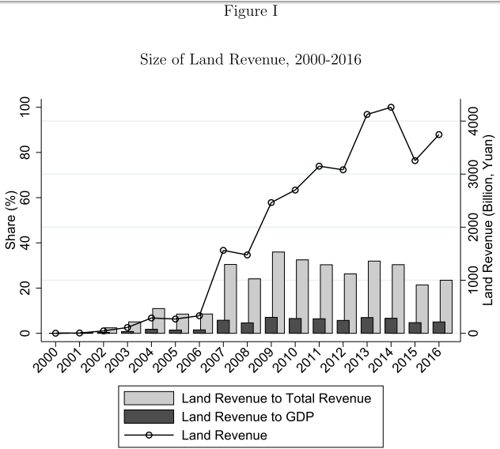
Corruption in China’s Primary Land Market

Slide 18
Xi’s Anti-Corruption Campaign
Xi Jinping singled out land as one of his main targets in the anti-corruption campaign. This campaign has several salient features
 Xi strengthened the CCDI. the new rule now requires the head of the provincial commission to be filled by officials from a different province and who are therefore “unlikely to be tied to local patronage networks”
 more intense and longer-lasting. in 2016 alone more than 100,000 low-ranking officials were indicted for corruption compared with a mere 30,315 in 2012
 the biggest breakthrough :unlike any previous political campaigns, Xi’s anti-corruption campaign targeted even the top party officials

Slide 19
03
Data Construction
03

Slide 20
Firms Connected to the Princelings
princelings here are the offspring and other extended family members of China’s leaders—specifically members of the Politburo and its Standing Committee
Corruption that tied to transactions in the primary land market, involves primarily children and family members of the elite party members who served between 1997 and 2016 (two reasons)
In our sample, there are altogether 64 Politburo members (between the 15th and the 18th). Of these 64 political elites, 36 are Politburo members and 28 are Standing Committee members during the period 1997-2016

Slide 21
Firms Connected to the Princelings
In our sample, there are altogether 64 Politburo members spanning four National Congresses (between the 15th and the 18th). Of these 64 political elites, 36 are Politburo members and 28 are Standing Committee members during the period 1997-2016
Upon identifying these political elites, we then searched online for their family members—children and relatives. Altogether we have identified 134 family members related to 48 Politburo and Politburo Standing Committee members
Altogether we identify 3,530 firms (including the subsidiaries) connected to at least one princeling

Slide 22
Matching Land Transactions with the Princeling Firms
According to the Ministry of Land and Resources, there were altogether 1,628,635 transactions (1997-2016), of which 1,151,358 land parcels
We then match the data on land transactions with those of the firms (including their subsidiaries) connected to the princelings based on the firm’s name

Slide 23
A Spatially Matched Sample for Identification
key challenge: causally identify the economic rents obtained by the princeling firms among a number of unobserved firm and transaction characteristics
use spatial matching approach
generate a sample of transactions involving land parcels purchased by firms unconnected to the princelings in the same year and within the same distances under the assumption that land parcels of a similar size and sold within the same area and in the same year are highly comparable in quality and therefore price.
 treat land parcels purchased by firms unconnected to the princelings as the control group, and any price difference between the parcels paid by these two types of firms can be attributed to the preferential treatment the local governments provide to the princeling firms

Slide 24
A Spatially Matched Sample for Identification
able to identify 359,539 land parcels within the 1500-meter radius and 207,564 land parcels within the 500-meter radius purchased by the non-princeling firms

Slide 25
04
Price Discount Obtained by Princeling Firms
04

Slide 26
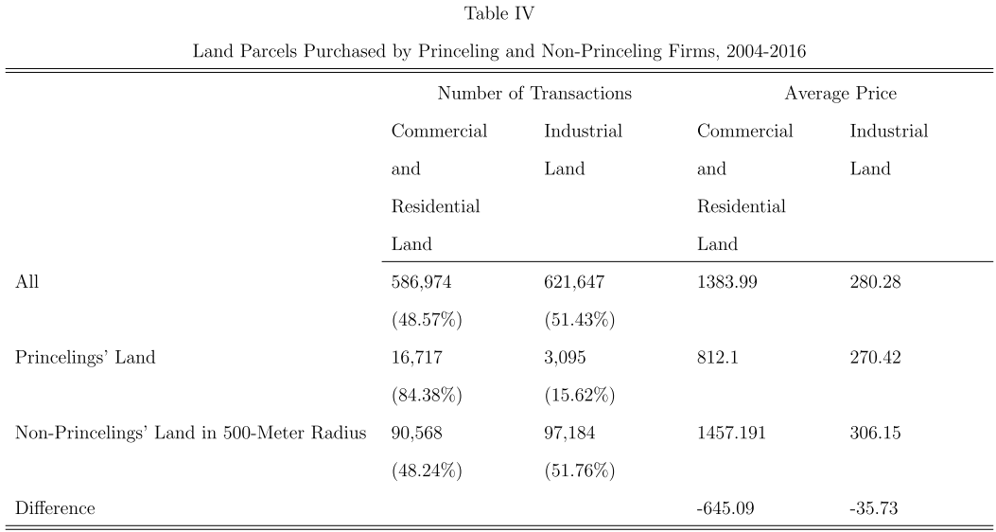
price discount obtained by the princeling firms

Slide 27
price discount obtained by the princeling firms
：the log of price (yuan per square meter) for land parcel i
sold by municipal government c to firm k for usage s in month-year t
：a dummy , equal to 1 if a firm k is connected to a princeling j,
and 0 otherwise
：transaction level variables including the log of the land area sold, land quality as evaluated by the officials in charge of selling the land, the specific sales method employed, firm size and firm ownership.
：a high-dimensional control of city-year-usage fixed effects, month fixed effects and the three-digit industry fixed effects

Slide 28
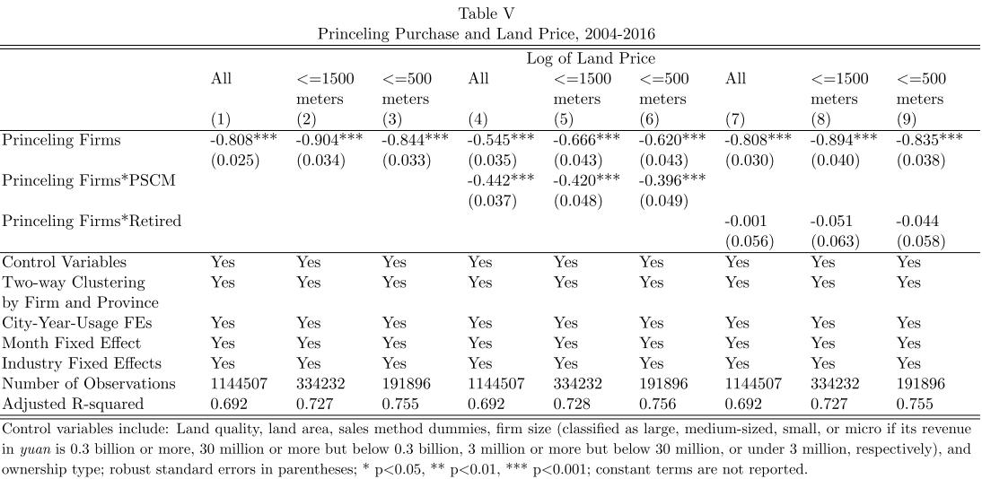
price discount obtained by the princeling firms
Basic results

Slide 29
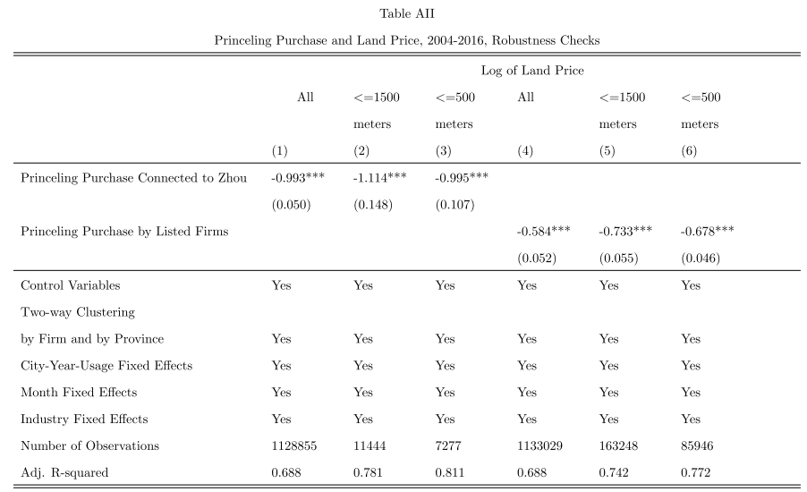
price discount obtained by the princeling firms
two robust checks

Slide 30
price discount obtained by the princeling firms
full sample: column (1)
matched sample: column (2) and (3)
heterogeneity
 political status of the princelings: column (4)-(6)
retirement:(7)-(9)
two robustness checks: table AII
 make use of the subsample of Zhou Yongkang
and his son to verify our main results
 employ a sample of the publicly listed firms that are
both connected to the princelings and have
purchased land in the primary land market as additional check

Slide 31
05
Effect of Business Favor on Promotion
05

Slide 32
Effect of Business Favor on Promotion
：promotion = 3, lateral transfer or staying in office = 2, retirement = 1,
and termination for wrongdoing such as corruption or natural death = 0
：a dummy that is equal to 1 where a provincial official provides a
discount to firms connected to the princelings, and 0 otherwise.
：whether a provincial official has ties with his/her patron in the Politburo
：control variables, such as GDP per capita and population size

Slide 33
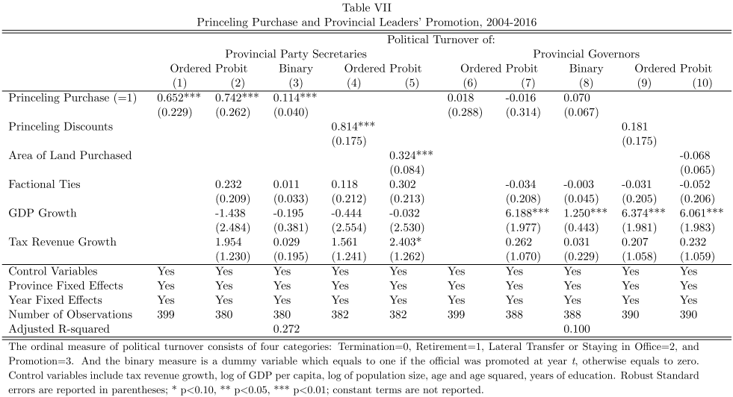
Effect of Business Favor on Promotion
Basic results

Slide 34
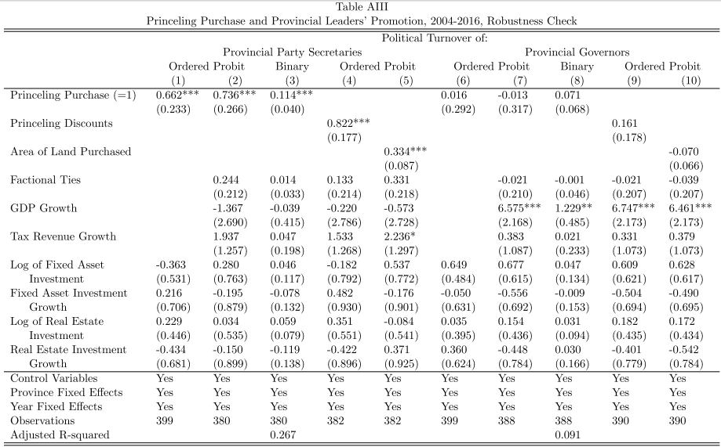
Effect of Business Favor on Promotion
two concerns

Slide 35
Effect of Business Favor on Promotion
Without any controls: column (1) and (6)
With Control : columns (2) and (7)
replace the ordinal measures of political turnover with a binary measure : columns (3) and (8)
 effect of the quantity of land sold to the princeling firms on
officials’ promotion: columns (5) and (10)
 aggregating the total area of land sold to the princeling
firms by province and year. To deal with the observations
of zero we add one to the variable before taking log
Two concerns
 confounding factor : Tables AIII
 is too rude measure: column (4) and (9)

Slide 36
06
Effect of Xi’s
Anti-Corruption Campaign
06

Slide 37
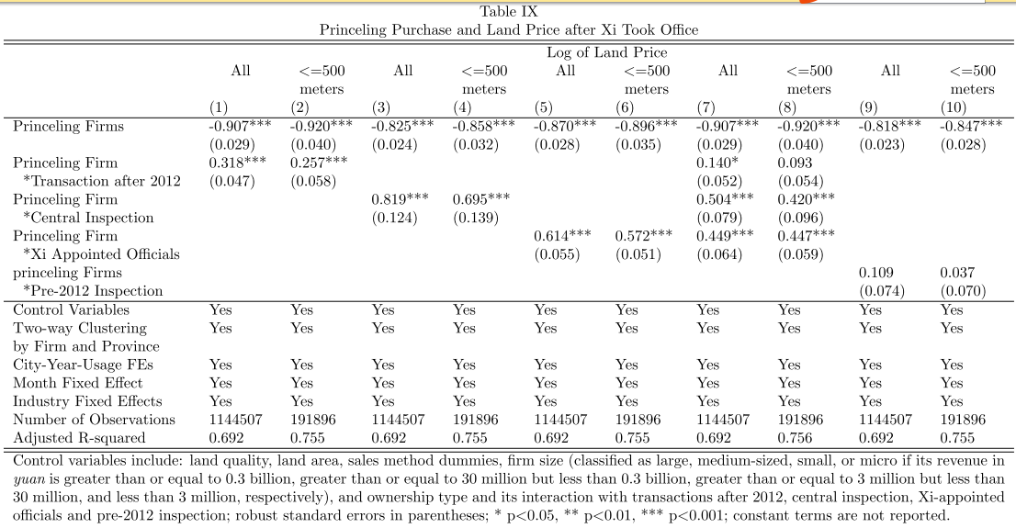
Effect of Xi’s Anti-Corruption Campaign on Land Price

Slide 38
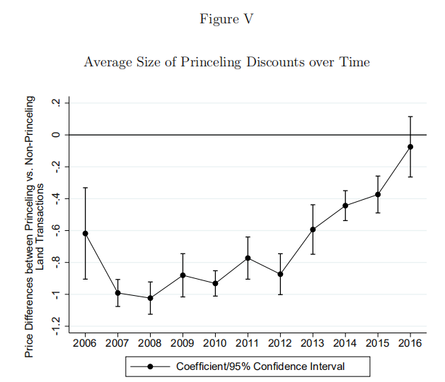
Effect of Xi’s Anti-Corruption Campaign on Land Price
the average size of the discounts obtained by the princeling firms over time

Slide 39
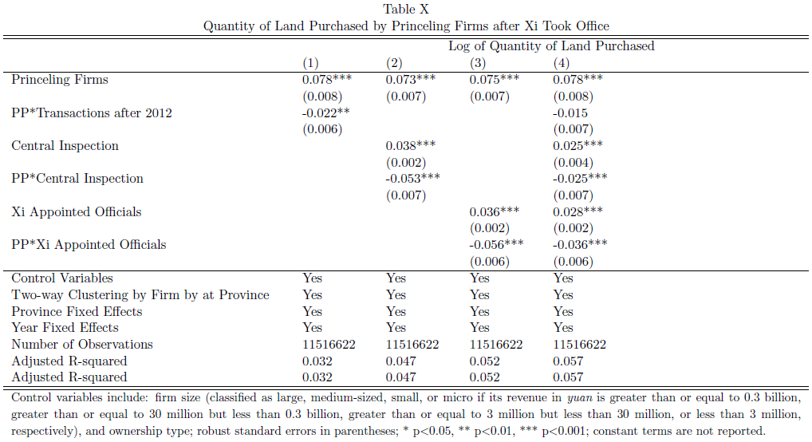
Effect of Xi’s Anti-Corruption Campaign on Quantity of Land Sold to the Princeling Firms

Slide 40
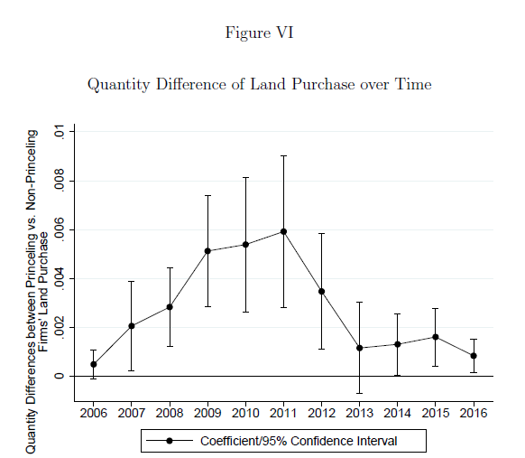
Effect of Xi’s Anti-Corruption Campaign on Quantity of Land Sold to the Princeling Firms
 the coefficients from the quantity of land purchased
by the princeling firms vis-`a-vis the non-princeling firms over time

Slide 41
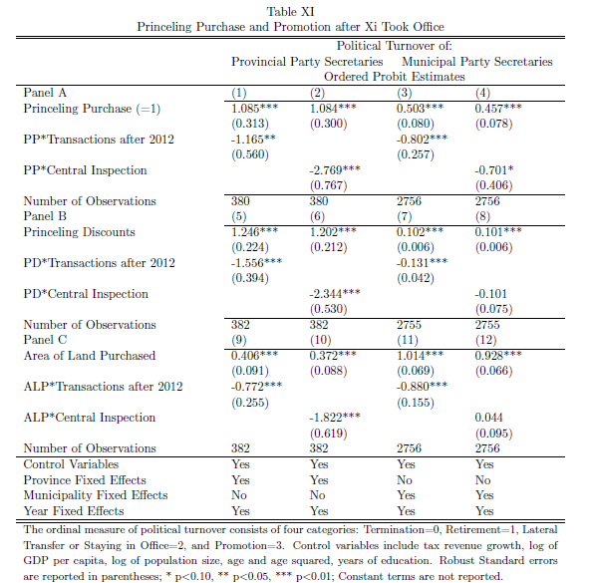
Effect of Anti-corruption on Political Turnover

Slide 42
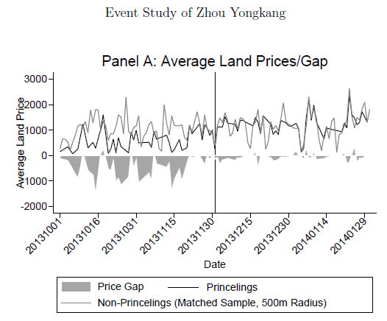
An Event Study of Zhou YongKang

Slide 43
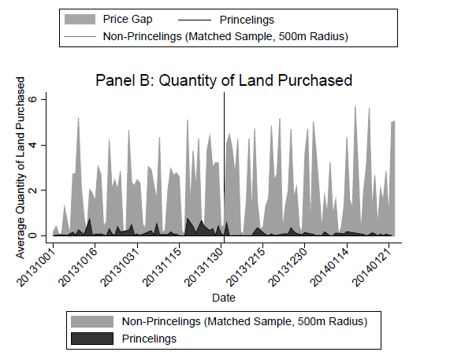
An Event Study of Zhou YongKang

Slide 44
07
Conclusion
07

Slide 45
price discount obtained by the princeling firms
 the price discount obtained by the princeling firms is a sizable 55.4%, when we compare the land parcels purchased by the princeling firms with those located in the same district, designated for the same usage and sold in the same month of the same year to non-princeling firms
 the more powerful the princeling, the larger the discount
 those provincial party secretaries who have provided a discount to princeling firms are 23.4% more likely to be promoted, with the likelihood of promotion increasing with both the size of the price discount and the quantity (area) of land sold to the princeling firms
 Xi’s anti-corruption campaign is effective. For land transactions that took place after 2012 the magnitude of the price discount has shrunk by 25.7-31.8% depending on the estimate

Slide 46
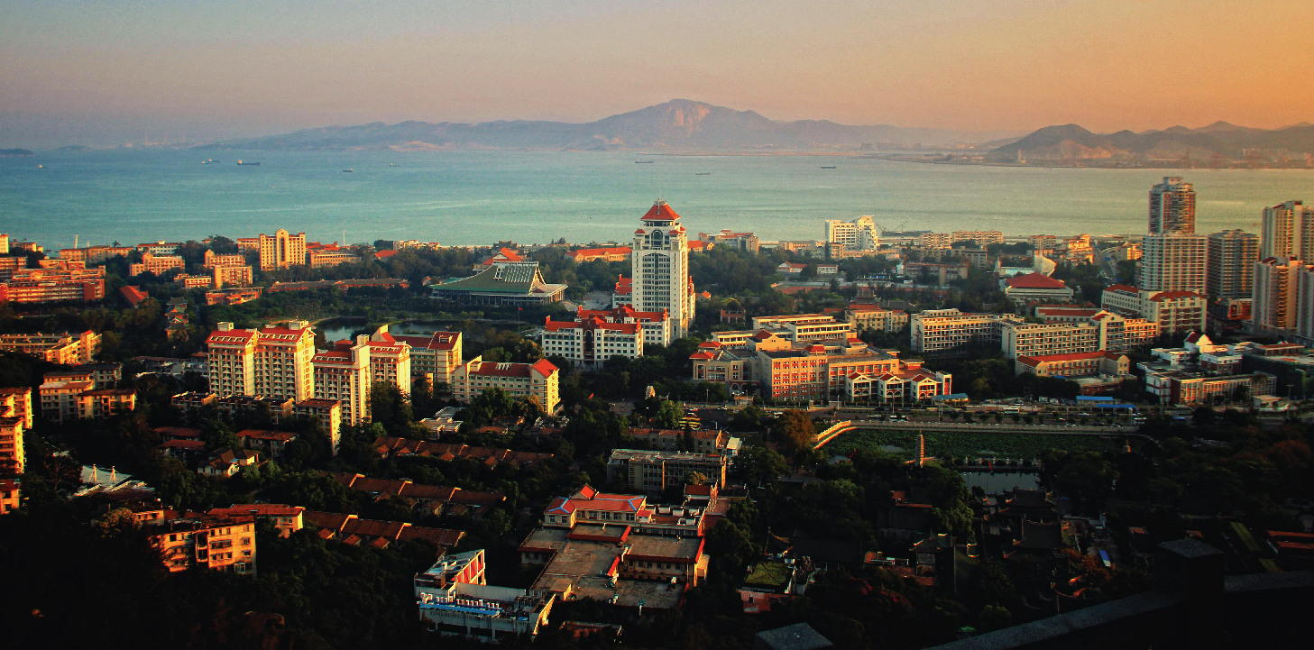
THANK YOU !
2018.11.23

