Slide 1
Does Banking Competition Alleviate or
Worsen Credit Constraints Faced by SMEs? Evidence from China
Terence Tai-Leung Chong, Liping Lu, Steven Ongena
延时符

Slide 2
1
Introduction
延时符

Slide 3
introduction
Backrounds:
The Chinese government has long recognized the difficulties SMEs face in obtaining financing and it has tried to help them in getting bank loans. SME financing was even added to the national development agenda, which in 2003 resulted in the ‘‘SMEs Promo-
tion Law’’. Therefore, to understand the determinants of SME financing in China is vita-lly important not only for academics but also for policymakers.

Slide 4
introduction
Contributions:
This paper contributes to the literature by providing evidence on the effect of banking sector concentration (intended to measure the intensity of competition) on SME credit constraints in China. We augment the survey with a new dataset of bank branches across China and employ a quantitative measure called the ratio of financing gap over credit demand to capture the information of credit constraints.

Slide 5
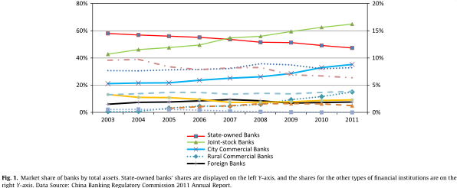
introduction

Slide 6
introduction
Banking system and SME financing:
About half of total banking assets were owned by these four state-owned banks in 2005, which usually provide funds to state-owned firms (which are often very large firms in their own right) and show much less interest in financing SMEs.
There are 12 joint-stock banks in China who can open branches freely around the country and their business orientation includes targeting SMEs.
There are city commercial banks (112 in total at the end of 2005), most of which were restructured from urban credit cooperatives. According to the financial regulation before 2006, city commercial banks could generally only operate within their headquarters cities, thus focusing exclusively on local banking markets and have a strong business orientation towards SMEs.
Joint-stock banks compete with state-owned banks for large firms and with the city commercial banks for SMEs. Competition in the banking market has increased substantially due to the joint-stock banks and city commercial banks’ burgeon.

Slide 7
2
Theoretical background
延时符

Slide 8
Theoretical background
Measurement for credit constraints:
Credit constraints arise from a shortfall in the supply of credit vis-à-vis the current de-mand for credit demand, which implies a financing gap exists.
Define a dummy variable (Constrained), which indicates whether a firm faces a financing gap, as:
Constrained = 1; if Financing Gap > 0; Constrained = 0; Otherwise (1)
Financing Gap = Credit Demand for Expansion + Credit Demand for Operation (2)
To gain insight on the proportion of the required investment which faces credit constraints, we devise a quantitative measure:
Financing Gap Ratio = Financing Gap / (Financing Gap + Credit Balances) (3)

Slide 9
Theoretical background
Measurement for competition:
We measure the intensity of banking competition by the Herfindahl–Hirschman Index (HHI) and the concentration ratio (CR3) using the banks’ market shares in terms of number of bank branches.
To capture the heterogeneous effect of joint-stock banks and city commercial banks, we define the Market Share of Joint Stock Banks and of City Commercial Banks as:
Market Share of JSB = $\sum_{j=1}^{Ji}{(\#branchj}/\sum_{k=1}^{Ki}{\#branchk})2/HHI$ (4)
Market Share of CCB = $\sum_{c=1}^{Ci}{(\#branchc}/\sum_{k=1}^{Ki}{\#branchk})2/HHI$ (5)
where HHI = $\sum_{k=1}^{Ki}{(\#branchk}/\sum_{k=1}^{Ki}{\#branchk})$², K, J and C are the number of banks for all three types of banks, joint stock banks, and city commercial banks respectively in a city. The market share measures the proportion of HHI contributed by joint-stock, and city commercial banks.

Slide 10
Theoretical background
Hypotheses:
1. More competition leads to a less binding credit constraint.
2. Competition by joint-stock banks and city commercial banks has a larger effect on credit constraints than competition by state-owned banks.

Slide 11
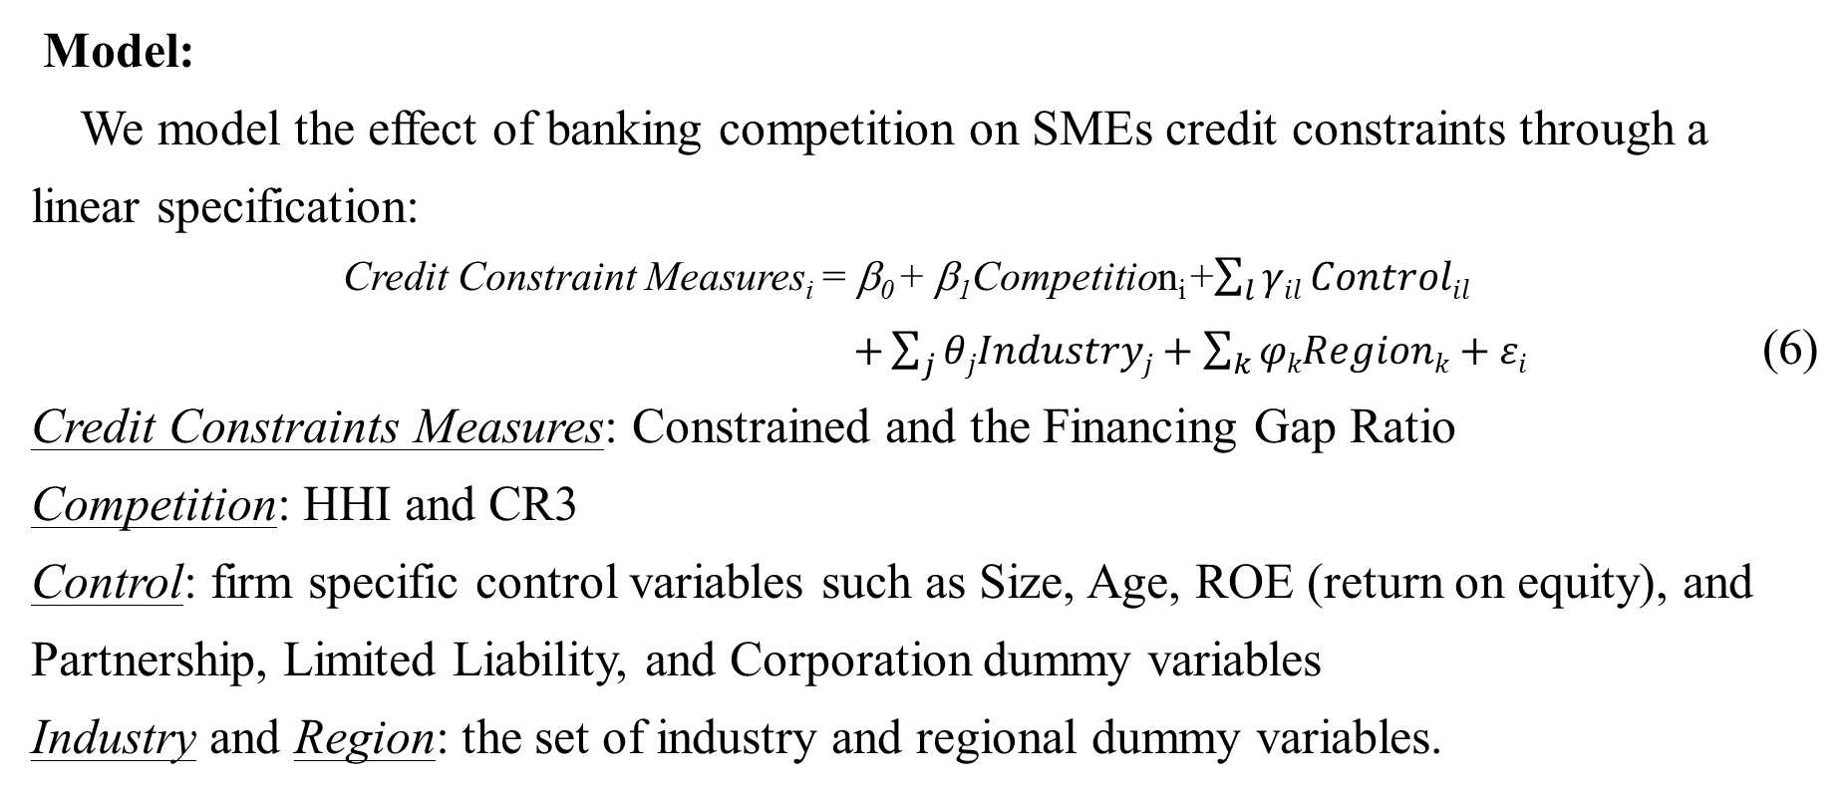
Theoretical background
Model:
We model the effect of banking competition on SMEs credit constraints through a linear specification:
Credit Constraint Measures_{i} = β₀ + β₁Competition_{i} +$\sum_{l}{γil}Controlil$
$+\sum_{j}{θjIndustryj+\sum_{k}{φkRegionk+εi}}$ (6)
Credit Constraints Measures: Constrained and the Financing Gap Ratio
Competition: HHI and CR3
Control: firm specific control variables such as Size, Age, ROE (return on equity), and Partnership, Limited Liability, and Corporation dummy variables
Industry and Region: the set of industry and regional dummy variables.

Slide 12
3
Data
延时符

Slide 13
Data
Data sources:
The data is composed of two parts: The SME survey dataset and hand-collected bank branch information.
A stratified survey dataset on Chinese private enterprises is available for the year 2006 which is obtained from University Service Center at The Chinese University of Hong Kong. The survey comprises 3837 observations, covering 31 regions in China.
We collect all bank branch information at the end of 2005 from their official websites, annual financial reports, government reports and a variety of other sources.
The number of bank branches is merged with the survey data at the prefecture-level city based on firms’ headquarters postcodes.

Slide 14
Data
Summary statistics:

Slide 15
4
Estimates
延时符

Slide 16
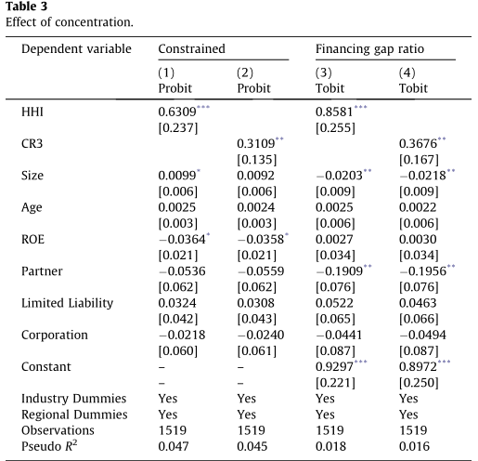
Estimates
In Table 3, The result shows that more banking competition, or a lower HHI/CR3, is associated with a lower probability of having credit constraints for SMEs. And banking competition also reduces its severity.

Slide 17
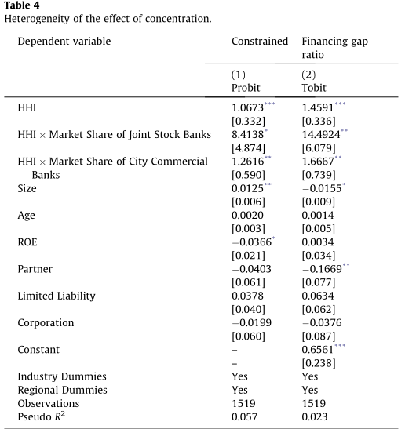
Estimates
Model (1) in Table 4 shows that the presence of joint-stock banks is indeed more effective than the presence of city commercial banks in alleviating credit constraints, while the presence of state-owned banks is less effective.
Model (2) implying that joint-stock banks and city commercial banks are more efficient than state-owned banks in reducing the financing gap ratio and joint-stock banks are more efficient than city commercial banks.

Slide 18
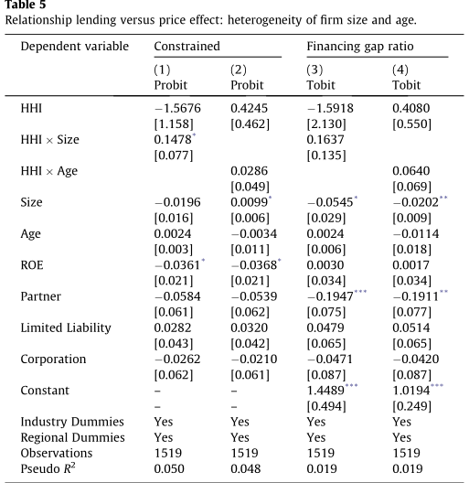
Estimates
There is no consistent evidence on the heterogeneous effect across firm size and age with respect to banking competition, which rules out relationship lending. The positive association between banking competition and credit availability must come through the price channel, or through the lowering of the interest rate.

Slide 19
Estimates
Endogeneity:
While more intense banking competition could help alleviate SME credit constraints, markets with more credit constrained firms may also attract more banks (that compete) which could further increase the intensity of banking competition. This reverse effect could lead to an endogeneity problem in the model specification.
Instrumental variable:
We instrument the concentration indices with the average value of the concentration indices of the neighboring cities in the same province. With each city treated as a separate market, the concentration indices of neighboring cities are not likely to affect local SMEs credit constraints due to transaction and information costs of cross-city lending.

Slide 20
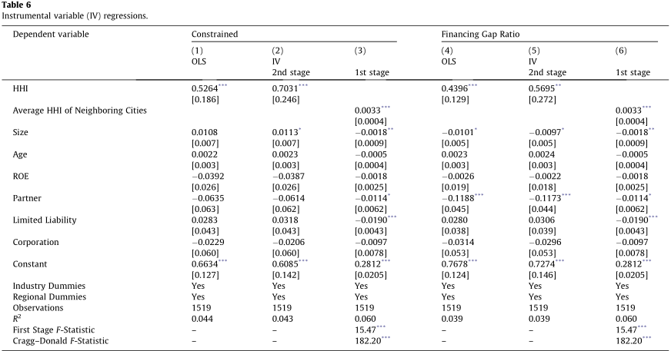
Estimates

Slide 21
Estimates
Model (2) of Table 6 shows that HHI is significant at the 1% level for Constrained. The magnitude of the coefficient is somewhat larger than the OLS model (1), which shows that the IV captures a part of the HHI’s variation. The IV regression confirms the relationship between banking competition and probability of credit constraints while assuaging the endogeneity concerns.
Model (5) yields positive coefficients for HHI significant at the 5% level and the magnitude of coefficient is a little larger than the OLS model (4), which confirms that more intense competition reduces the financing gap ratio. The IV regressions confirm the robustness of the claim that more intense banking competition could lead to a lower financing gap ratio.

Slide 22
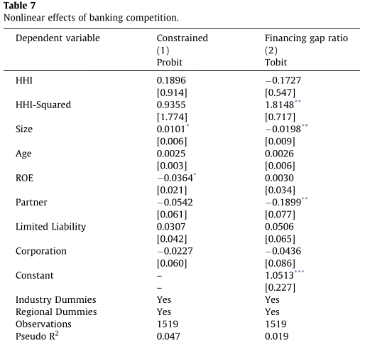
Estimates
Robustness checks:
Banking competition seems to have no non-linear effects for the neither the probability of the presence of credit constraints nor the size of the credit constraints.

Slide 23
5
Conclusion
延时符

Slide 24
Conclusion
Using a survey dataset on Chinese SMEs, we investigate how banking competition contributes to alleviating credit constraints both in terms of the probability that SMEs face credit constraints and in terms of the magnitude of the credit constraints they face.
Moreover, we find that the joint-stock banks have a larger effect, while the state-owned banks have a smaller effect, than city commercial banks in reducing the probability SMEs that face credit constraints and on the magnitude of the credit constraints. Put differently, banking competition by different types of banks can lead
to heterogeneous effects on the credit constraints faced by SMEs.

Slide 25
PPT模板下载：www.1ppt.com/moban/ 行业PPT模板：www.1ppt.com/hangye/
节日PPT模板：www.1ppt.com/jieri/ PPT素材下载：www.1ppt.com/sucai/
PPT背景图片：www.1ppt.com/beijing/ PPT图表下载：www.1ppt.com/tubiao/
优秀PPT下载：www.1ppt.com/xiazai/ PPT教程： www.1ppt.com/powerpoint/
Word教程： www.1ppt.com/word/ Excel教程：www.1ppt.com/excel/
资料下载：www.1ppt.com/ziliao/ PPT课件下载：www.1ppt.com/kejian/
范文下载：www.1ppt.com/fanwen/ 试卷下载：www.1ppt.com/shiti/
教案下载：www.1ppt.com/jiaoan/ PPT论坛：www.1ppt.cn
谢谢指导

