Slide 1
Household Expenditure and the Income Tax Rebates of 2001
Author: Johnson D.S., Parker J.A., and Souleles N.S.,
Source: The American Economic Review, Vol.96, No.5(Dec., 2006), pp.1589-1610
Speaker ：Liming Hou
2018.10.18

Slide 2
C
ONTENT
01
Introduction
02
Literature
03
Data and Variables
04
Empirical Models and Results
05
Conclusion

Slide 3
Introduction
01
01
Comparisons
Background

Slide 4
Comparisons
Last week’s paper:
The Response of Household Consumption to Income Tax Refunds
Author: Nicholas S. Souleles
Source: The American Economic Review, Vol.89, No.4(sep., 1999), pp.947-958
Similar topic and results:
(1) test PIH and reject
(2) short-run response of rebates ; liquidity constraints ;
Different data structure and discussions:
(1) rebates: three month vs one year
(2) long-run response of rebates ; heterogeneity .

Slide 5
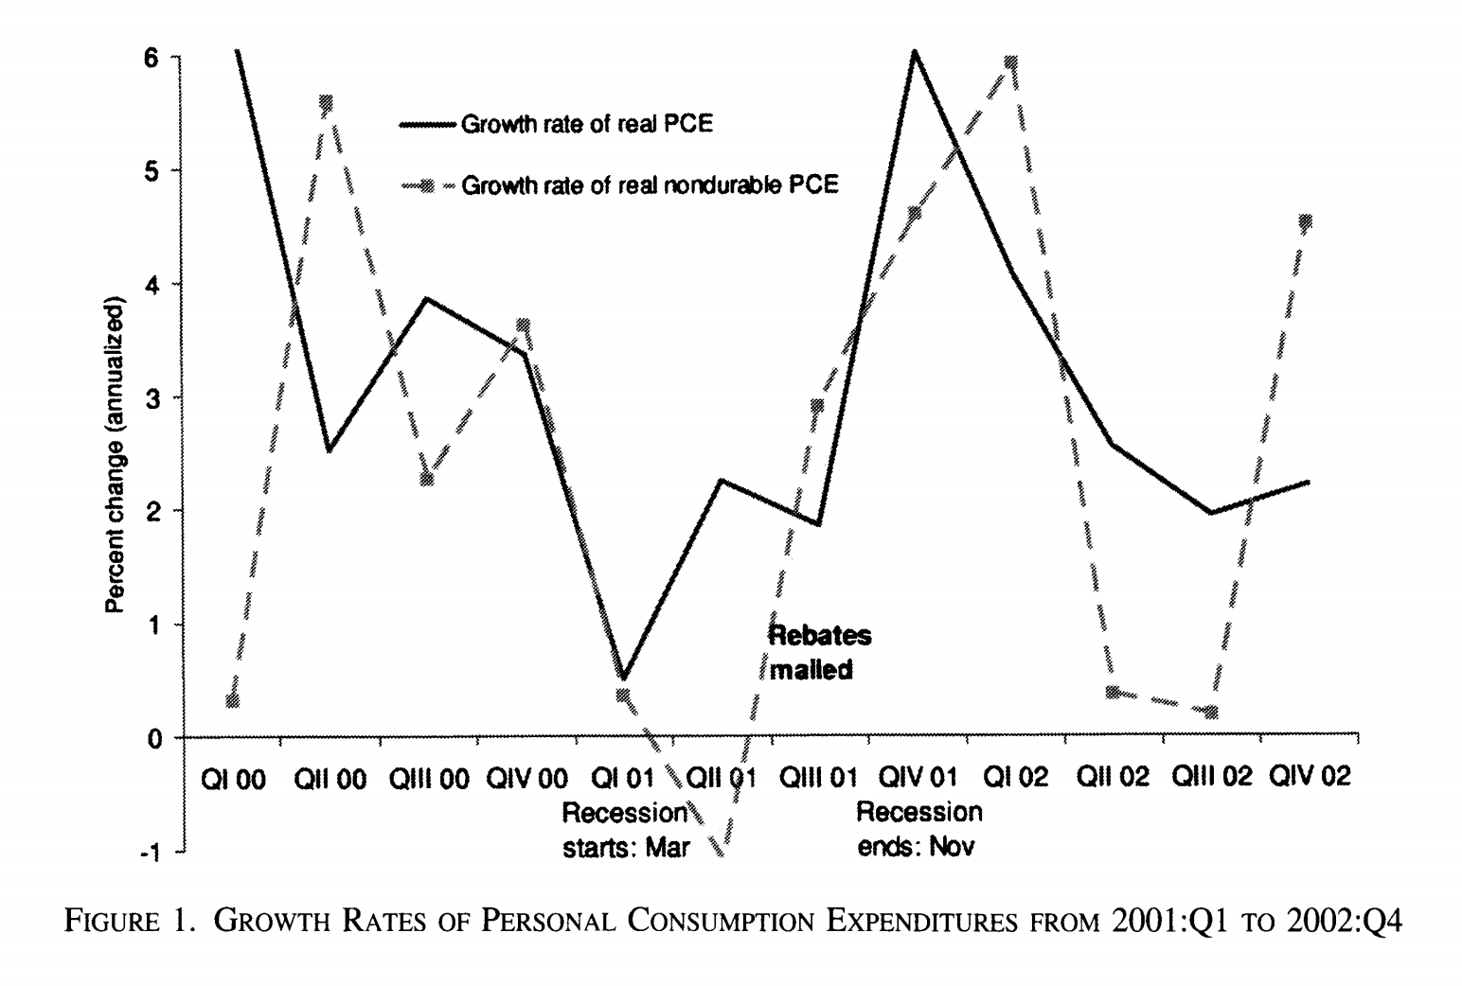
Background

Slide 6
Background
The 2001 Tax Rebates
The Economic Growth and Tax Relief Reconciliation Act of 2001 sent tax rebates, typically $300 or $600 in value, to most U.S. households over a ten-week period from late July to the end of September 2001. The unique feature of these rebates is that the timing of the mailing of each rebate was based on the second-to-last digit of the Social Security number (SSN) of the tax filer who received it, a digit that is effectively randomly assigned.

Slide 7
Background
In the previous literature, it is difficult to find clean measures of predictable (or transitory) income changes, and isolate their effect from other factors that have an impact on the consumption decision (e.g., concurrent changes in the stock market). And the utilized change in household income is usually constructed as a function of observed household characteristics. For the resulting estimates of the consumption response to be consistent, these characteristics must be uncorrelated with all other unobserved determinants of consumption growth rate.
A key advantage of the present paper is that the random variation in the timing of the 2001 tax rebates satisfy this assumption, helping to avoid these recurrent difficulties in the literature.

Slide 8
Background
The Consumer Expenditure Survey
The regular CE data do not record the timing of taxes and transfers within the year. However, shortly after the passage of the 2001 Tax Act, the authors worked with the staff of the Bureau of Labor Statistics (BLS) and other government agencies to add a special module of questions about the tax rebates to the CE survey. This module asked households about the timing and amount of each rebate check they received, and was included in the survey from shortly after the rebate mailing began until the end of 2001.

Slide 9
02
02
Literature

Slide 10
Literature
Two papers study the impact of the 2001 tax rebates
Shapiro and Slemrod (2003a) find that 21.8 percent of respondents who received (or expected to receive) a rebate report that they will mostly spend their rebate, which is calculated to imply an average marginal propensity to consume of about one third, consistent with the estimate below of the short-run response of expenditure.
Sumit Agarwal et al. (2004) also exploit the random timing of the rebate mailing, using credit-card data, to identify the dynamic response of credit-card payments, spending, and debt to the rebates. The paper finds that households initially used some of their rebates to increase credit-card payments and thereby pay down debt and increase liquidity.

Slide 11
03
03
Data and Variables

Slide 12
Data and variables
Expenditures
CE households are interviewed up to four times, three months apart, to collect expenditure information. In each interview, they report their expenditures during the preceding three months.
Different aggregated measures of consumption expenditures:
Notes: Since the response of total expenditures to the rebates was never statistically significant, this paper focus on nondurable expenditures.

Slide 13
Data and variables
Rebates
The special module of questions about the 2001 rebates covers the crucial period during which and after the rebates were mailed: the module went into the field in the second week of August, and remained there through the end of
December. These questions were asked at the end of the CE interview, after households completed their usual reporting of expenditures and other information.
The variable Rebate is the sum of all rebates reported during the three-month expenditure reference-period. And this rebate is received during the ten-week period as mentioned.
(The Economic Growth and Tax Relief Reconciliation Act of 2001 sent tax rebates, typically $300 or $600 in value, to most U.S. households over a ten-week period from late July to the end of September 2001. )

Slide 14
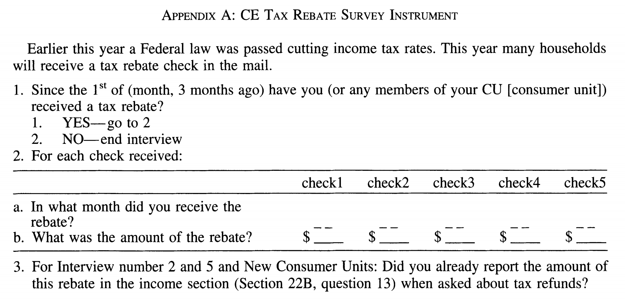
Data and variables

Slide 15
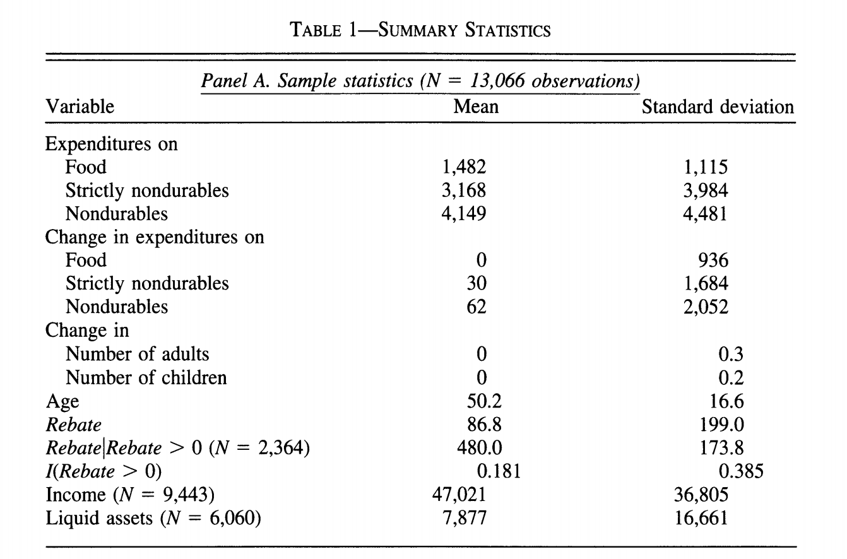
Summary Statistics

Slide 16
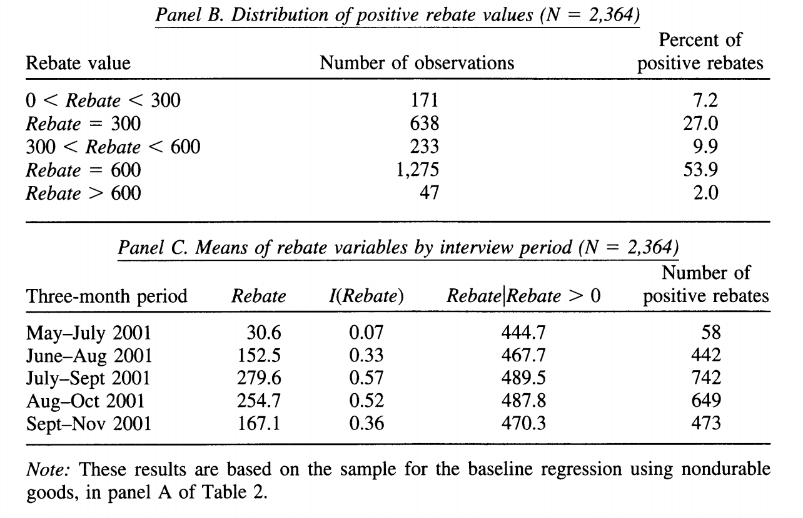
Summary Statistics(cont.)

Slide 17
04
Empirical Models and Results
Baseline Model
The short-run response of expenditure
The long-run response of expenditure
Differences in responses across households and goods
04

Slide 18
04
Empirical Models and Results
Baseline Model
The short-run response of expenditure
The long-run response of expenditure
Differences in responses across households and goods
04

Slide 19
PIH under rational expectations

Slide 20
Baseline Model
$C_{i,t+1}−C_{i,t}=\sum_{s}{β_{0s}}∗{month}_{s,i}+β_{i}^{′}∗X_{i,t}+β_{2}∗R_{i,t+1}+u_{i,t+1}（$1）
$C_{i,t+1}$: either consumption expenditures or their log;
${month}_{s,i}$: a complete set of indicator variables for every period in the sample;
$X_{i,t}$: control variables, eg. age and changes in family composition;
$R_{i,t+1}$: take one of the three forms below:
The total dollar amount of rebates received by household i in period t+1; $R_{i,t+1}$
(2) A dummy variable indicating whether any rebate was received in t+1; I($R_{i,t+1}$>0)
(3) A distributed lag of $R_{i,t+1}$ or I($R_{i,t+1}$>0), to measure the longer-run effects of the rebates.
H0: $β_{2}$=0

Slide 21
04
Empirical Models and Results
Baseline Model
The short-run response of expenditure
The long-run response of expenditure
Differences in responses across households and goods
04

Slide 22
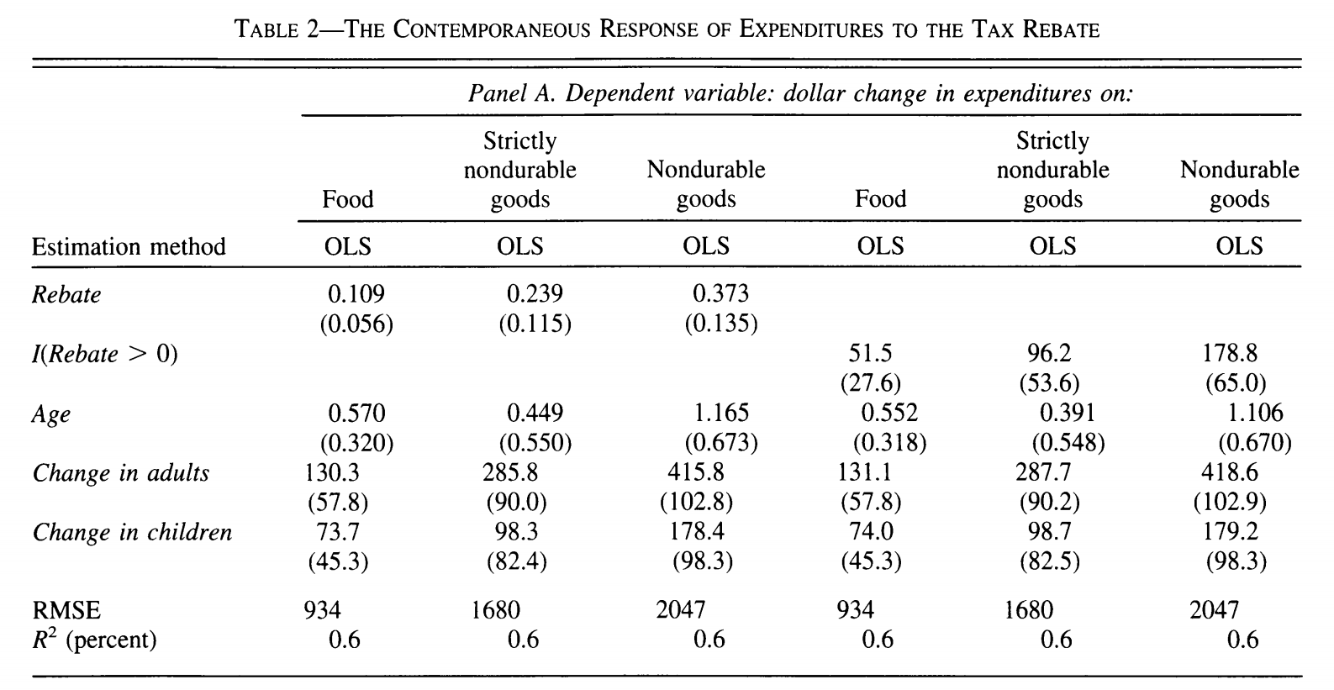
The short-run response of expenditure

Slide 23
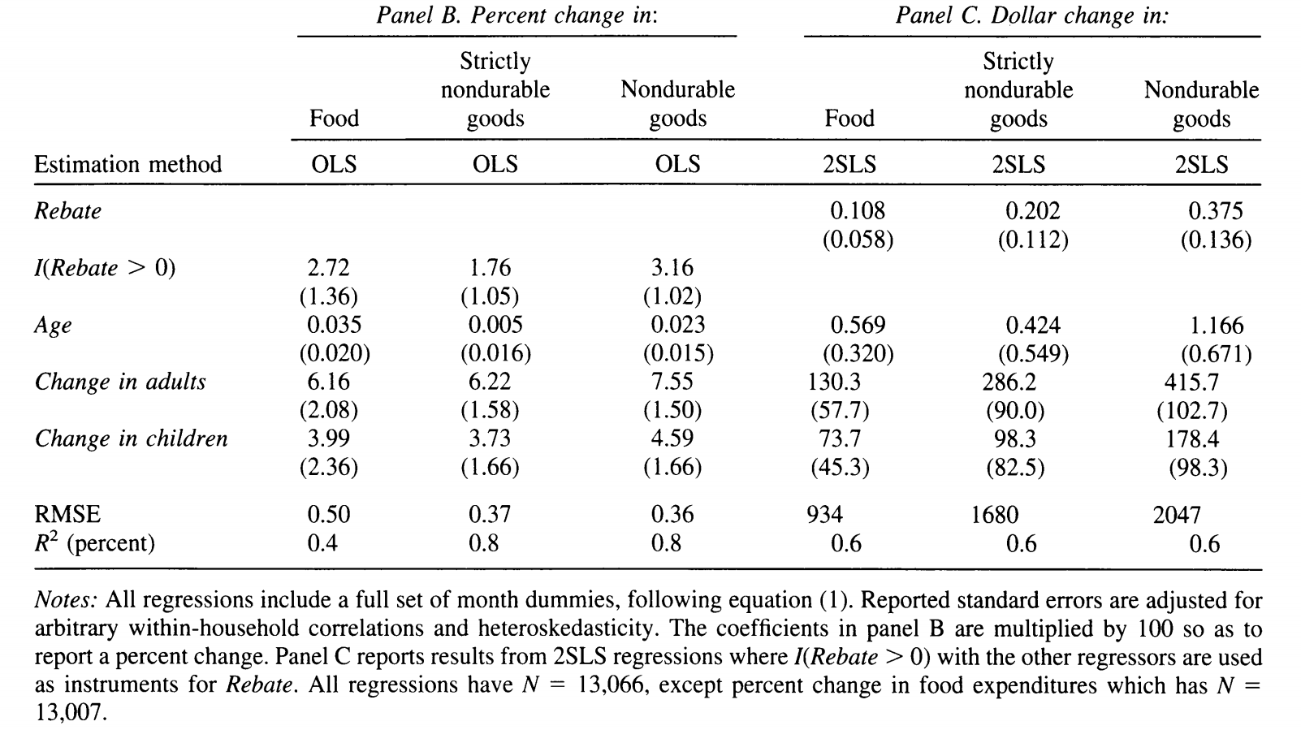
The short-run response of expenditure
(log C)

Slide 24
The short-run response of expenditure
Overall, the results across the various specifications in Table 2 are quite consistent, implying a statistically significant short-run effect of the rebate on spending.
However, recall that some households did not receive rebates at all, in any period, so these results implicitly use some information that comes from comparing households that received rebates to those that never received rebates.
Table 3 investigates the role of this variation using a number of approaches.
directly control for rebate receipt, by adding to baseline model an indicator for households that received a rebate in any reference quarter, I($total rebates$>0).—— in panel A.
exclude from the raw sample all households that did not receive a rebate ($total rebates$>0). —— in panel B.

Slide 25
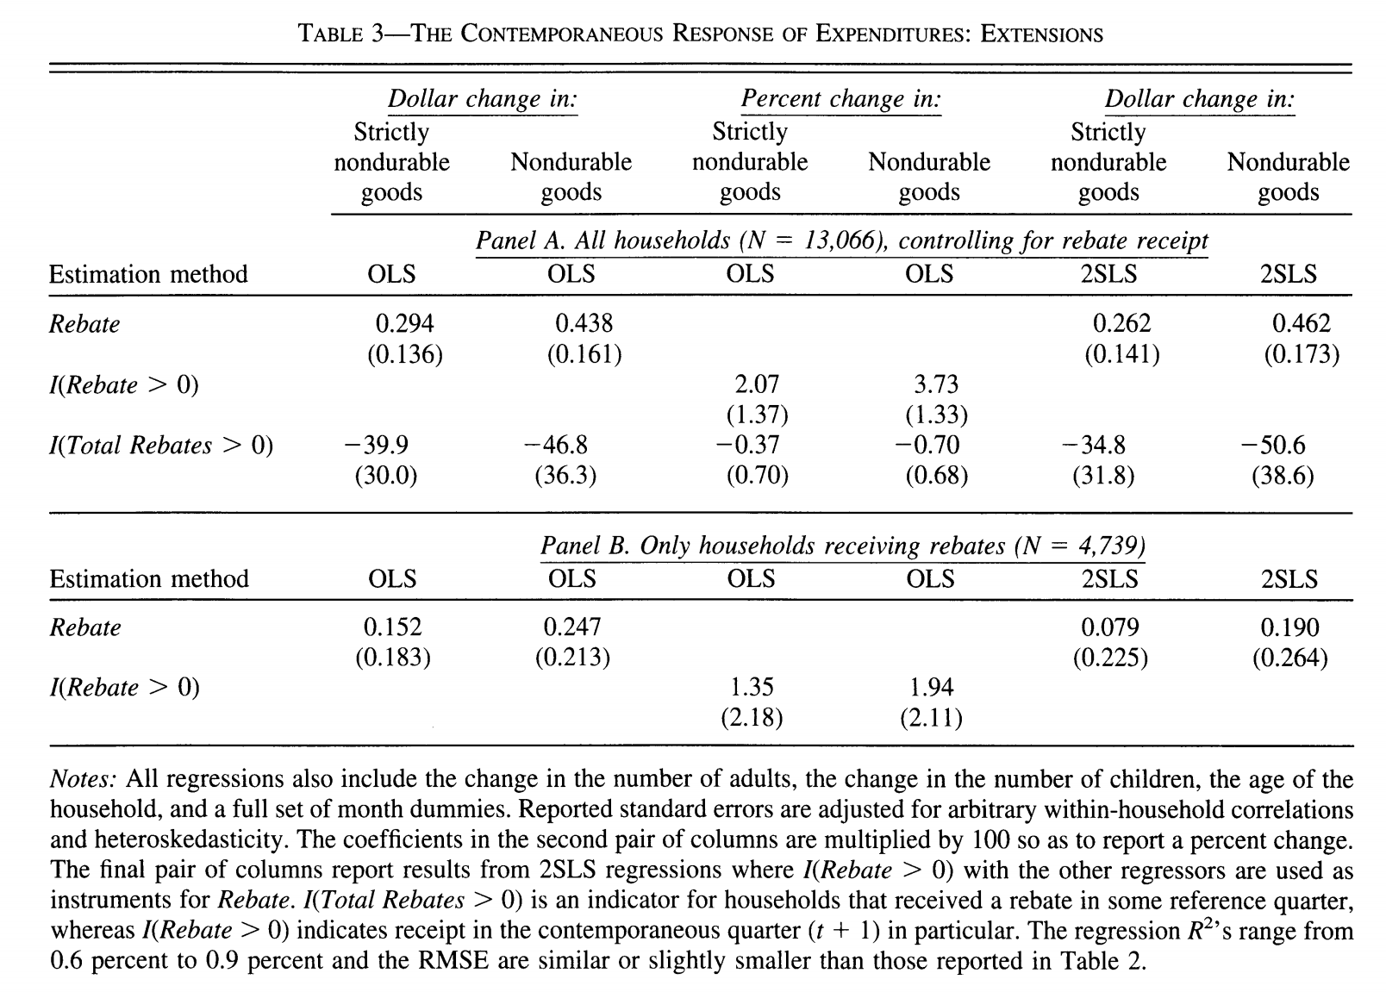
The short-run response of expenditure

Slide 26
04
Empirical Models and Results
Baseline Model
The short-run response of expenditure
The long-run response of expenditure
Differences in responses across households and goods
04

Slide 27
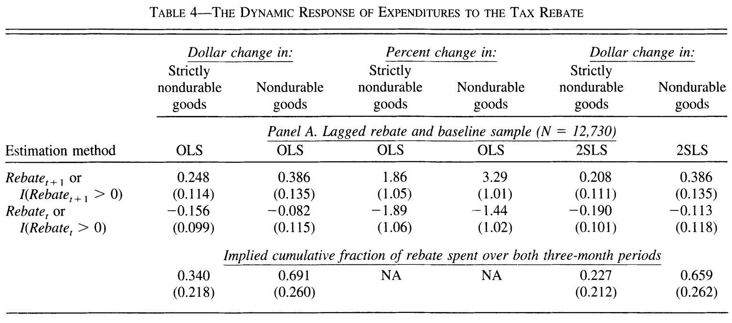
The long-run response of expenditure
$C_{t+1}−C_{t}\sim 0.386$ $R_{t+1}$ (1)
$C_{t}−C_{t−1}\sim 0.386 R_{t}$(3)
$C_{t+1}−C_{t}\sim −0.082$ $R_{t}$ (2)
Plus (2)and (3)
$C_{t+1}−C_{t−1}\sim 0.304R_{t}$ (4)
$C_{t+2}−C_{t}\sim 0.304R_{t+1}$ (5)
Plus (1)and (5)
($C_{t+1}−C_{t})+(C_{t+2}−C_{t})\sim 0.690R_{t+1}$ (6)

Slide 28
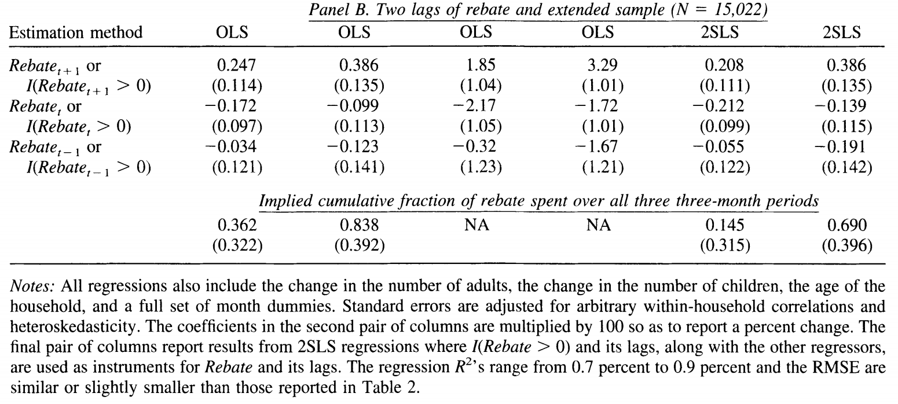
The long-run response of expenditure

Slide 29
04
Empirical Models and Results
Baseline Model
The short-run response of expenditure
The long-run response of expenditure
Differences in responses across households and goods
04

Slide 30
Differences in responses across households and goods
This section analyzes heterogeneity in the response to the rebate, across different types of households and different subcategories of consumption goods.
The presence of liquidity constraints is a leading explanation why household might increase in response to a previously expected increase in income.
Households with low liquid wealth may be unable or unwilling to increase their spending prior to the rebate arrival. On the other hand, households with high liquid wealth may find the utility costs of not smoothing consumption across the arrival of the rebate to be small (Ricardo J. Caballero, 1995; Parker, 1999; Christopher A. Sims, 2003; Ricardo Reis, 2004).

Slide 31
Differences in responses across households and goods
We use three different variables to identify households that are potentially
liquidity constrained: age, income (family income before taxes), and liquid assets (the sum of balances in checking and saving accounts).
For each variable, we split households into three groups, Low, High, and the baseline intermediate group, with the cutoffs between groups chosen to include about a third of the rebate recipients in each group.
Age: young households typically have low liquid wealth and high income growth, they are disproportionately likely to be liquidity constrainted(e.g., Tullio J, 1990; Jappelli et al., 1998)

Slide 32
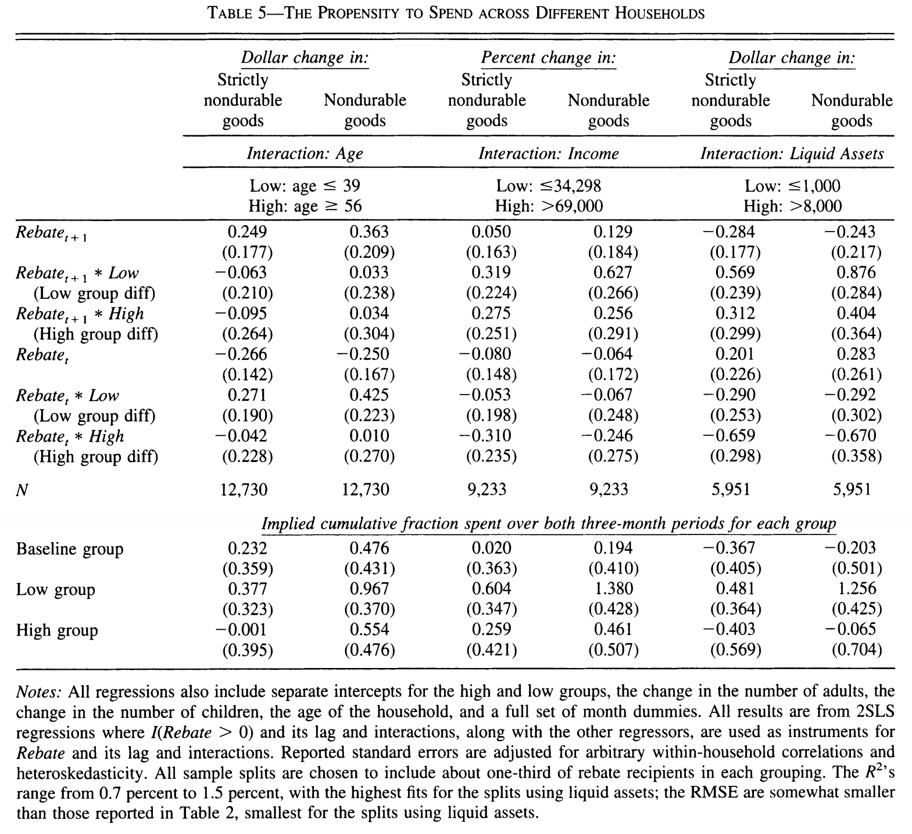
Differences in responses across households and goods

Slide 33
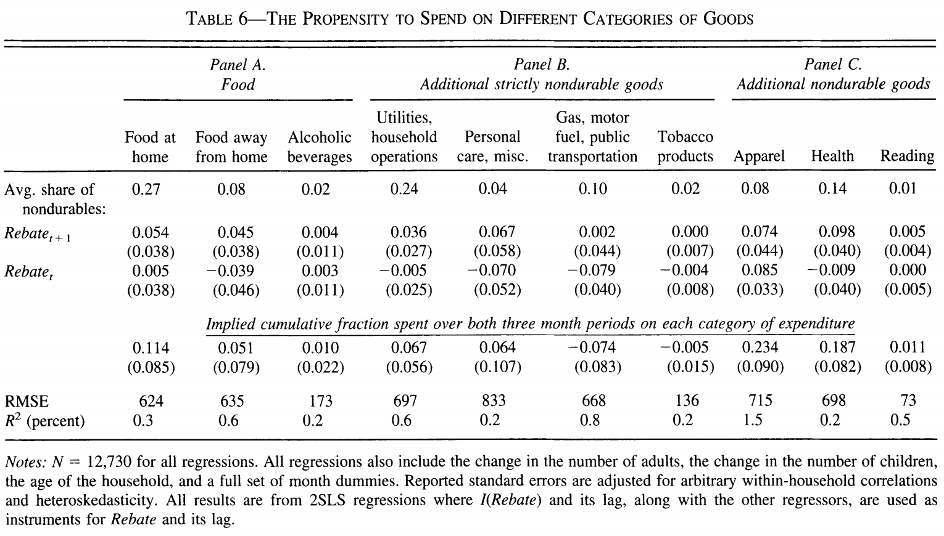
Differences in responses across households and goods
total (0.695)

Slide 34
05
05
Conclusion

Slide 35
Conclusion
This paper finds significant evidence that households spent much of their 2001 income tax rebates shortly after they arrived. Specifically, households spent about 20 to 40 percent of their rebates on nondurable consumption goods during the three-month period in which the rebates were received, depending on the specification, and roughly two-thirds of their rebates cumulatively during the quarter of receipt and subsequent three-month period. These results are inconsistent with the benchmark rational-expectations PIH. The expenditure responses are relatively large for households with relatively low liquid wealth or low income, which is consistent with the presence of liquidity constraints.

Slide 36
THANK YOU !
2018.10.17

