Slide 1
Small business lending and the changing structure of the banking industry
Philip E. Strahan, James P. Weston
延时符

Slide 2
1
Introduction
延时符

Slide 3
introduction
Backrounds:
Consolidation is sweeping the banking industry. One of the forces driving this increa-sed consolidation is deregulation of restrictions on geographical expansion, which was recently completed with passage of the Riegle–Neal Interstate Banking and Branching Efficiency Act of 1994 (IBBEA). IBBEA allows banks to form bank and branch networ-ks across state lines.
According to the 1993 National Survey of Small Business Finance, banks supply more than 60 percent of small business credit. Small businesses tend to concentrate their borrowing at a single bank with which they have a long-term relationship. Since there may be little public information available on small firms, relationships enable banks to collect private information on the credit worthiness of small firms.

Slide 4
introduction
Research objectives:
What is the relationship between the size and complexity of a banking company and its ability to originate and hold small business loans? How has small business lending changed after banking company mergers or acquisitions?

Slide 5
introduction
Forecast:
There are two potential forces that would tend to affect the relationship between banking company size and lending. First, diversification reduces delegated monitoring costs and improves internal capital markets; these effects should lower the costs of risky lending as size increases. Second, organizational diseconomies associated with size and complexity may increase the relative costs of small business (relationship) lending as size and com-plexity increase.
Small business lending per dollar of assets actually increased after mergers and acquisi-tions between small banking companies. We find no significant change following mergers or acquisitions between medium-sized and large banking companies.

Slide 6
2
Empirical tests
延时符

Slide 7
Empirical tests
Data sources:
In June 1993, the federal banking agencies began collecting data on small bank loans to businesses which appears annually in the June Report of Condition and Income (the Call Report) filed by all commercial banks.
We refer to all commercial and industrial (C&I) loans with original amounts under $1 million as ‘‘small business loans’’.

Slide 8
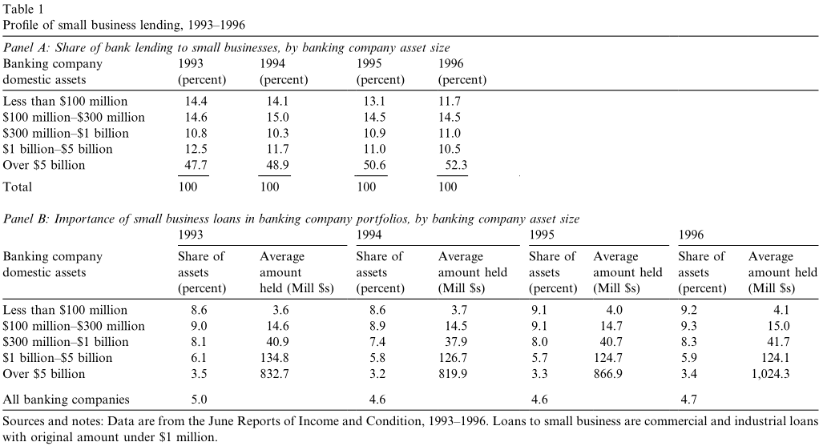
Empirical tests
Cross-sectional lending patterns:

Slide 9
Empirical tests
Size, complexity and small business lending:
Our results are more consistent with the idea that diversification enhances bank lending, both small and large, as size increases rather than the idea that organizational diseconomies reduce small business lending with increases in size.

Slide 10
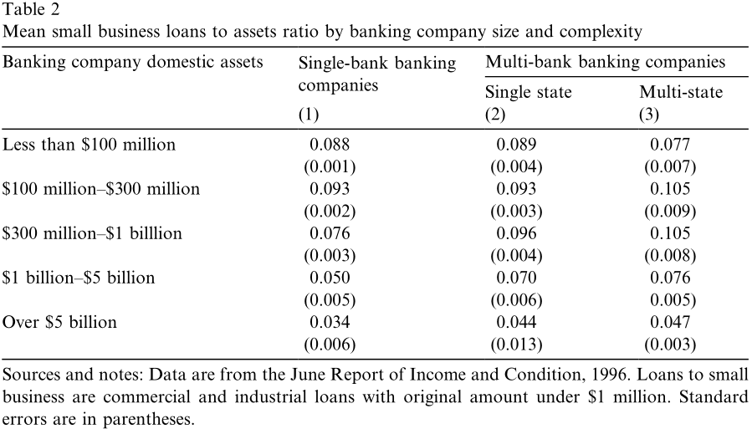
Empirical tests
Size, complexity and small business lending:

Slide 11
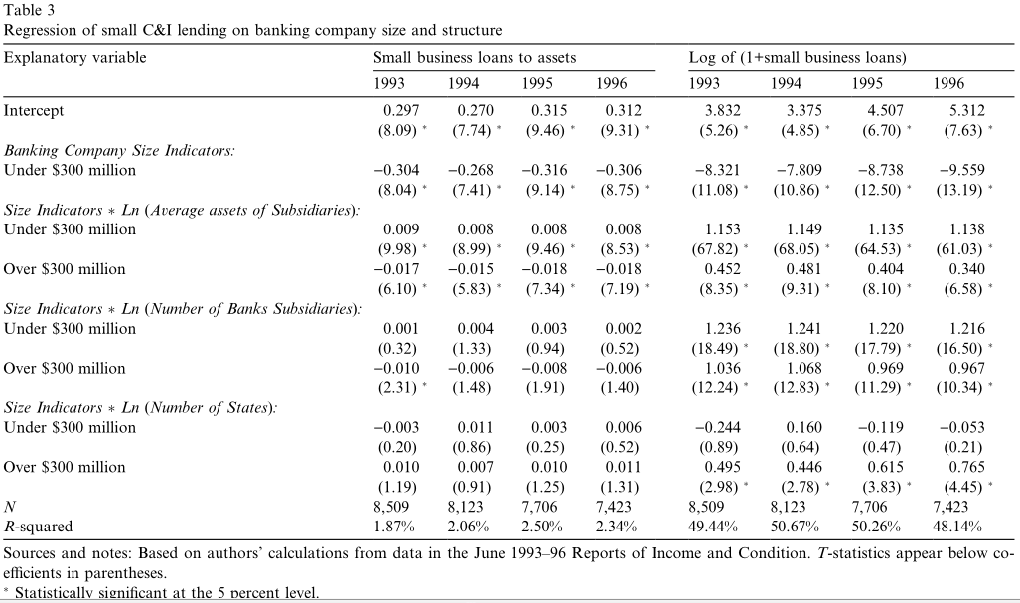
Empirical tests
Size, complexity and small business lending:

Slide 12
Empirical tests
Bank consolidation and small business lending:
To test directly whether consolidation leads to increases or decreases in small business lending, we construct a sample of 563 banking companies active in merger and/or acquisi-tion activity (M&A) and compare changes in their small business lending before and after the consolidation with banking companies not involved in any M&A activity over the same period.
To make the comparisons across time for the banking companies active in M&A, we construct a pro-forma banking company for each acquirer by summing the assets and liabilities of all of its bank subsidiaries as well as all of the banks that it acquired between 1 July 1993 and 30 June 1996 as of 30 June 1993 (before any of the M&A activity had actually occurred).
We construct our matched sample by randomly selecting one non-merging banking company for each of the acquiring banking companies with total domestic assets within 10 percent of the pro-forma banking company’s domestic assets as of the beginning of the period (1993). Since we do the matching without replacement, we were only able to match 489 of the 563 acquirers.

Slide 13
Empirical tests
Bank consolidation and small business lending:

Slide 14
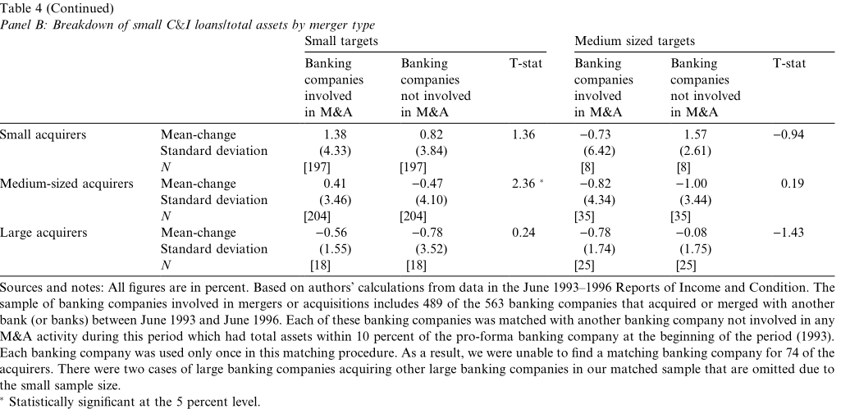
Empirical tests
Bank consolidation and small business lending:

Slide 15
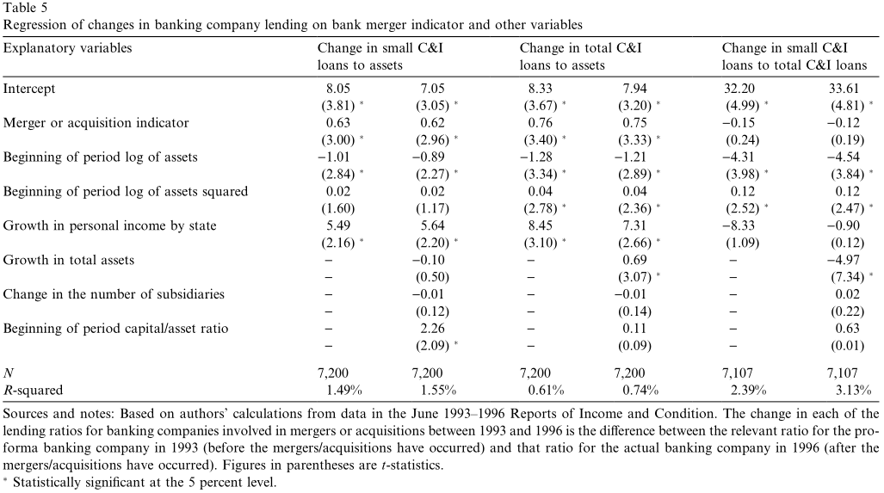
Empirical tests
Bank consolidation and small business lending:

Slide 16
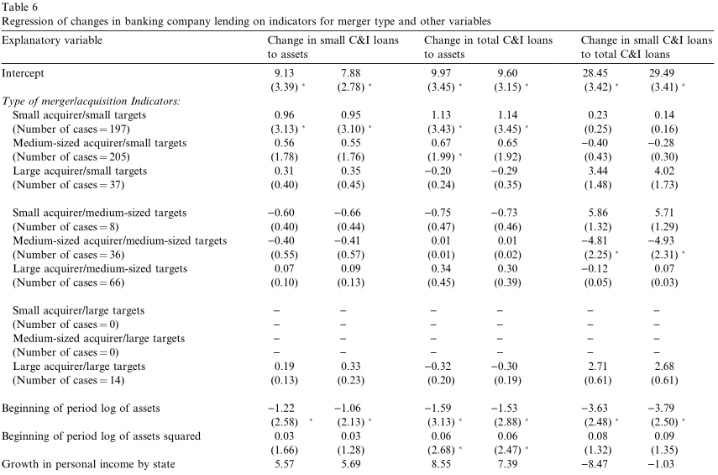
Empirical tests
Bank consolidation and small business lending:

Slide 17
3
Conclusion
延时符

Slide 18
Conclusion
In cross-section, small business lending increases per dollar of assets until banking companies reach about $300 million in assets. For larger banking companies, lending to large businesses increases rapidly with size, resulting in a slow increase in the level of small business lending but a decline in its importance in the portfolio. These patterns are consistent with the idea that size-related diversification enhances bank lending to both large and small businesses. More directly, we find that consolidation among small banking companies serves to increase bank lending to small businesses, while other types of mergers or acquisitions have little effect.

Slide 19
PPT模板下载：www.1ppt.com/moban/ 行业PPT模板：www.1ppt.com/hangye/
节日PPT模板：www.1ppt.com/jieri/ PPT素材下载：www.1ppt.com/sucai/
PPT背景图片：www.1ppt.com/beijing/ PPT图表下载：www.1ppt.com/tubiao/
优秀PPT下载：www.1ppt.com/xiazai/ PPT教程： www.1ppt.com/powerpoint/
Word教程： www.1ppt.com/word/ Excel教程：www.1ppt.com/excel/
资料下载：www.1ppt.com/ziliao/ PPT课件下载：www.1ppt.com/kejian/
范文下载：www.1ppt.com/fanwen/ 试卷下载：www.1ppt.com/shiti/
教案下载：www.1ppt.com/jiaoan/ PPT论坛：www.1ppt.cn
谢谢指导

