Slide 1
Financial constraints in China: Firm-level evidence
Sandra PONCET, Walter STEINGRESS, Hylke VANDENBUSSCHE
延时符

Slide 2
1
Introduction
延时符

Slide 3
introduction
Capital market imperfections are believed to be very present in China. The “political pecking order” in the allocation of credit where private Chinese firms were disadvantaged should in principle have been alleviated since 1998. But casual evidence suggests that credit constraints for private firms are still present which may impede the growth of the Chinese economy.
In this paper, we analyze whether different types of firm ownership face a different degree of financial constraints and investigate how Foreign Direct Investment (FDI) and the presence of state firms interact with the credit constraints that appear to exist for Chinese private firms.

Slide 4
introduction
Some limitations:
1. The regressor cash flow is an endogenous variable. Using lagged values of the endogenous variable as IV. However, lagged values are theoretical instruments but
not ideal.
2. The panel dimension of data is relatively short. This limits the number of lags we can use as instruments in the IV identification strategy.

Slide 5
2
Theoretical background
延时符

Slide 6
Theoretical background
In the presence of capital market imperfections, financing constraints will be reflected in firms' investment decisions. Financial constraints are measured by the sensitivity of investment with respect to internally generated funds i.e. cash flow.
In this paper we focus on institutional imperfections in Chinese credit markets and the hypothesis that access to credit is based on ownership i.e. the political pecking order that leads to a gap between the costs of internal versus external financing. To test different ownership effects, we split our sample between private, state-owned and foreign companies.

Slide 7
Theoretical background
Assume constant returns to scale production function with quadratic adjustment costs of investment.
I: gross investment in fixed assets
L: the number of employees
K: the level of the real capital stock (proxied by total assets)
ΔTU: the change in turnover
CF: cash flow
The subscripts i, k and t denote the firm, industry and time period, μ_{k,t} captures the sector-time specific effects, ε_{i,t} is the error term.

Slide 8
3
Data
延时符

Slide 9
Data
We use a unique micro-level data set over the period 1998–2005 on Chinese firms originating from the Oriana data set. Afte reliminating the observations that were based on irregular reports or unreasonable data values in the levels of variables, we have a total of 22,311 observations from 14,967 firms. We delete the upper and the lower one percentile of the distribution of the dependent variable to get rid of outliers.
Table 1 reports the summary statistics of the firms used in our empirical work according to their ownership structure, which shows that private Chinese firms are smaller than SOEs, generate more internal funds and are typically more efficient in investing their capital.

Slide 10
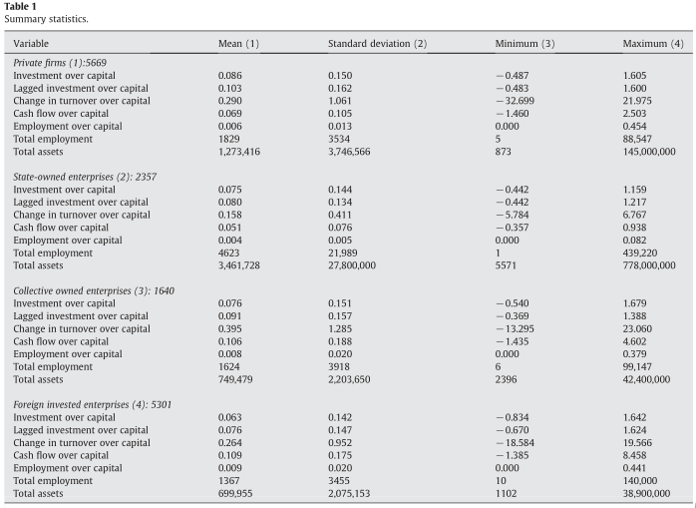
Data

Slide 11
4
Estimates
延时符

Slide 12
Estimates
In Table 2, we find that private firms in China significantly rely on their cash flow to
finance their investments, which is evidence of credit constraints, while SOEs and foreign firms do not.
In columns 4 to 6 we apply an IV technique where we use the cash flow over assets in periods t−2 and t−3 as instruments.
In columns 7 to 9, we include firm fixed effects to control for all unobserved time-invariant variables. we also include a squared cash flow term to allow for non-linearities in credit constraints. The negative and significant sign on the squared term suggests that a higher cash flow moderates the extent of the credit constraint for private Chinese firms.

Slide 13
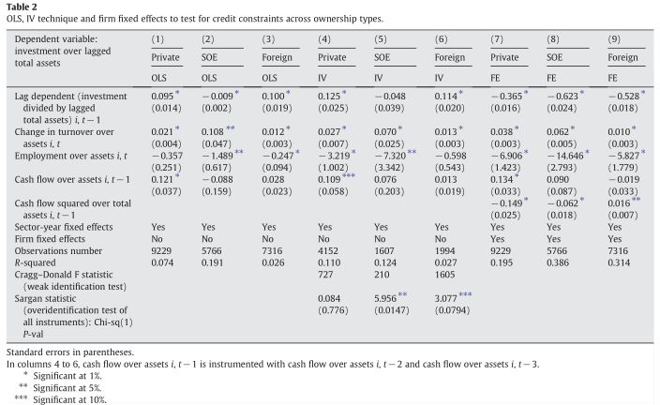
Estimates

Slide 14
Estimates
In Table 3, we turn to alternative measures of internal finance as an additional robustness check. We use the ratio of “total liabilities over total assets” as a firm-level measure of financial distress.
We find the coefficient on “total liabilities to assets” to be negative (and highly significant) only for private companies, meaning that high existing liabilities in terms of total assets indeed reduce the firm's capacity to invest. Our proxy for financial distress, does not affect the public companies' and foreign companies' investment.

Slide 15
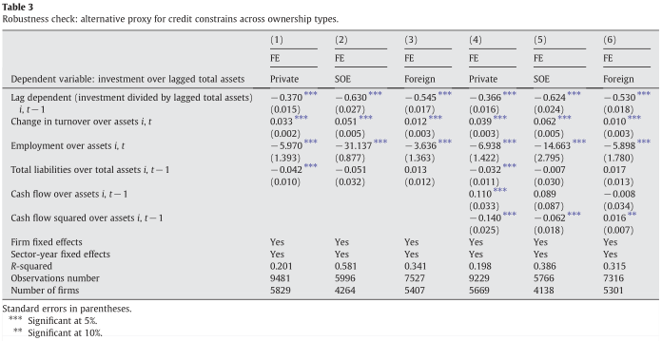
Estimates

Slide 16
Estimates
At the beginning of the 1980s, the Chinese government decided to gradually liberalize its regime for inward FDI by creating several “special economic zones” (SEZ) to attract foreign investment.
To see whether the presence of FDI alleviates financial constraints for private Chinese firms in the same province, we use the basic model and include the ratio of “trade credit over total assets” and variables measuring the importance of foreign investment, both as a main effect and interacted with our proxy for credit constraints.

Slide 17
Estimates
To evaluate whether foreign investment in China and state presence affect the magnitude of credit constraints, we use three types of measurements.
Traditional province-level indicators: the ratio of FDI over GDP and the ratio of employment in state-owned firms over total employment.
Rely on information of the fixed asset investment by source of financing: share of fixed assets investment financed by foreign sources and share of fixed assets investment financed by the state budget.
use four alternative size measures by looking at tangible assets, total assets, turnover and sales carried out by foreign firms versus state firms respectively at the province p and sector (2-digit) k level as follows:

Slide 18
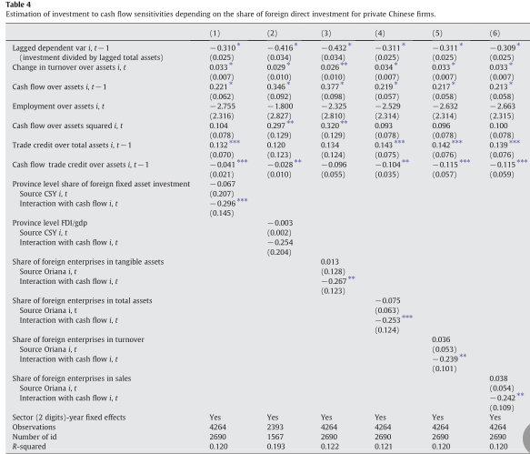
Estimates

Slide 19
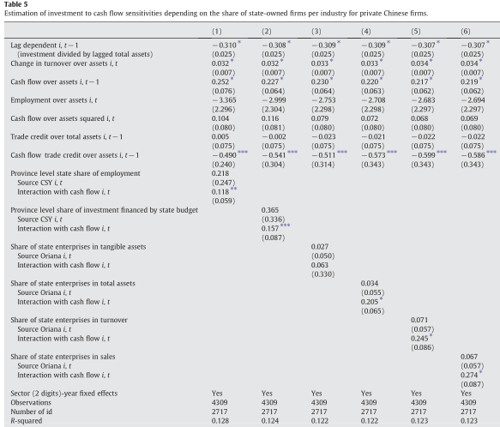
Estimates

Slide 20
5
Conclusion
延时符

Slide 21
Conclusion
The results over the period 1998–2005 suggest that private Chinese firms face severe financial constraints while we find no such constraints for state-owned and foreign enterprises. We identify FDI as an important mechanism for private Chinese firms to overcome financial constraints. In contrast, the size of the state-owned corporate sector negatively affects the extent to which private Chinese firms' investment depends on internal finance.

Slide 22
PPT模板下载：www.1ppt.com/moban/ 行业PPT模板：www.1ppt.com/hangye/
节日PPT模板：www.1ppt.com/jieri/ PPT素材下载：www.1ppt.com/sucai/
PPT背景图片：www.1ppt.com/beijing/ PPT图表下载：www.1ppt.com/tubiao/
优秀PPT下载：www.1ppt.com/xiazai/ PPT教程： www.1ppt.com/powerpoint/
Word教程： www.1ppt.com/word/ Excel教程：www.1ppt.com/excel/
资料下载：www.1ppt.com/ziliao/ PPT课件下载：www.1ppt.com/kejian/
范文下载：www.1ppt.com/fanwen/ 试卷下载：www.1ppt.com/shiti/
教案下载：www.1ppt.com/jiaoan/ PPT论坛：www.1ppt.cn
谢谢指导

